Slide 1
Aircraft Sizing and Design Optimization
Peter Sharpe
MIT 16.82: Flight Vehicle Engineering Tuesday, September 20, 2022

Slide 2
The Aircraft Design Process
You are here!
Conceptual
Preliminary
Detailed
Configuration (concept selection)
Performance verification
Low-fidelity analyses
Mid-to-high-fidelity point analysis
Sizing (optimization)
Part Design
Goals:
(Requirements feedback)
Configuration freeze
Risk reduction: Detailed design and/or building of key subsystems
Uncertainty analysis, probabilistic performance modeling
Testing of key subsystems
Finalize mass/power/cost budgets, cross-check against initial estimates.
OML, primary structure, internal layout defined
Mass/volume/power/cost budgets defined

Slide 3
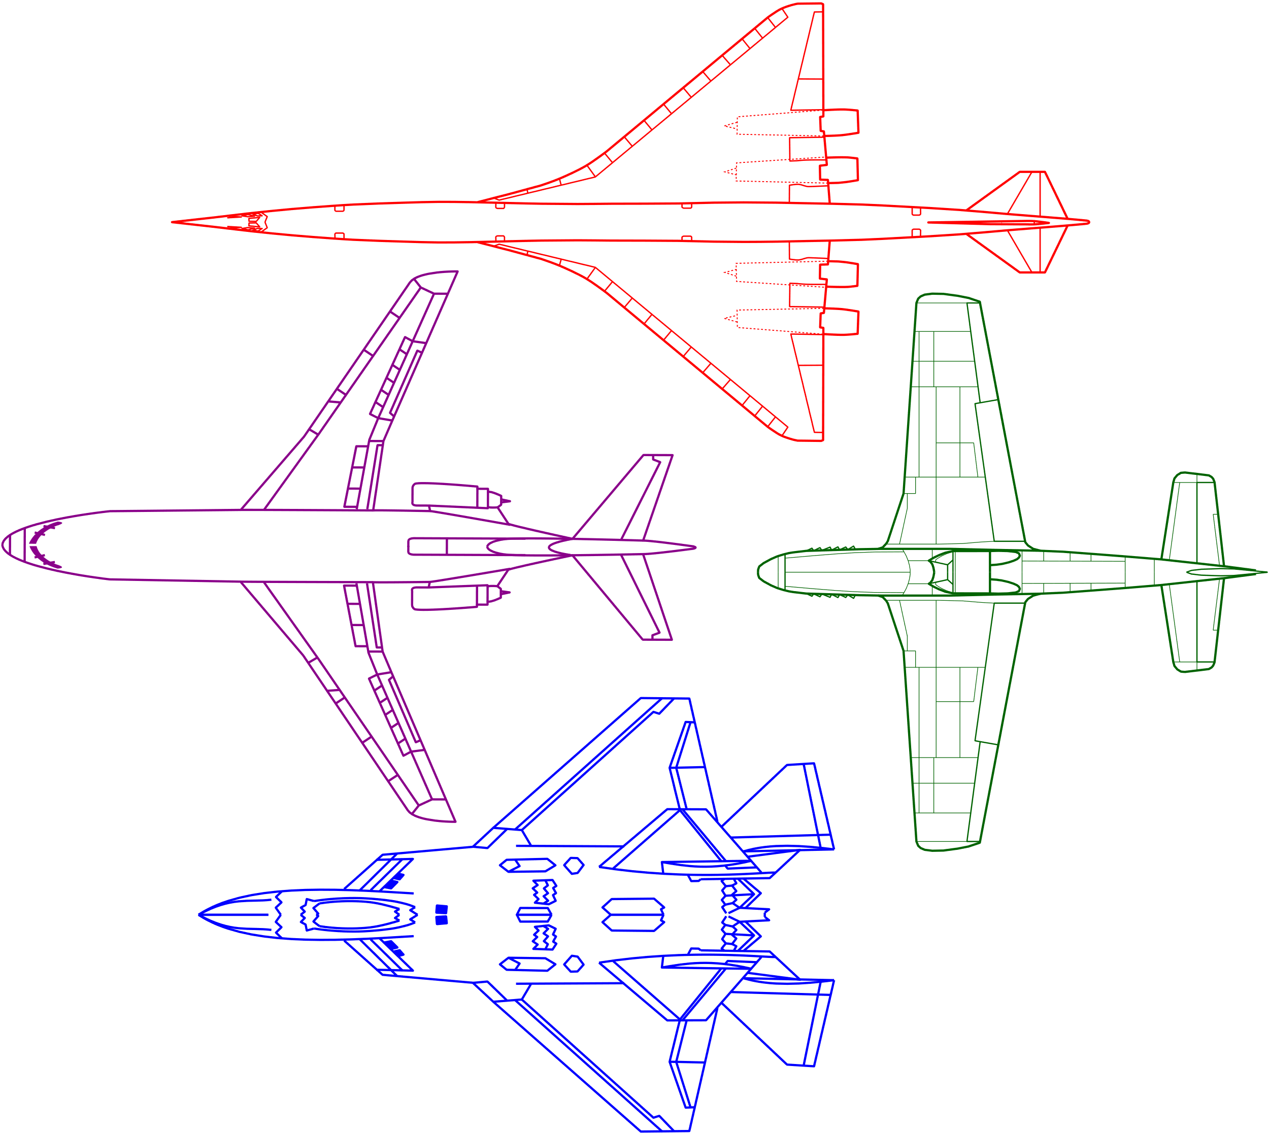
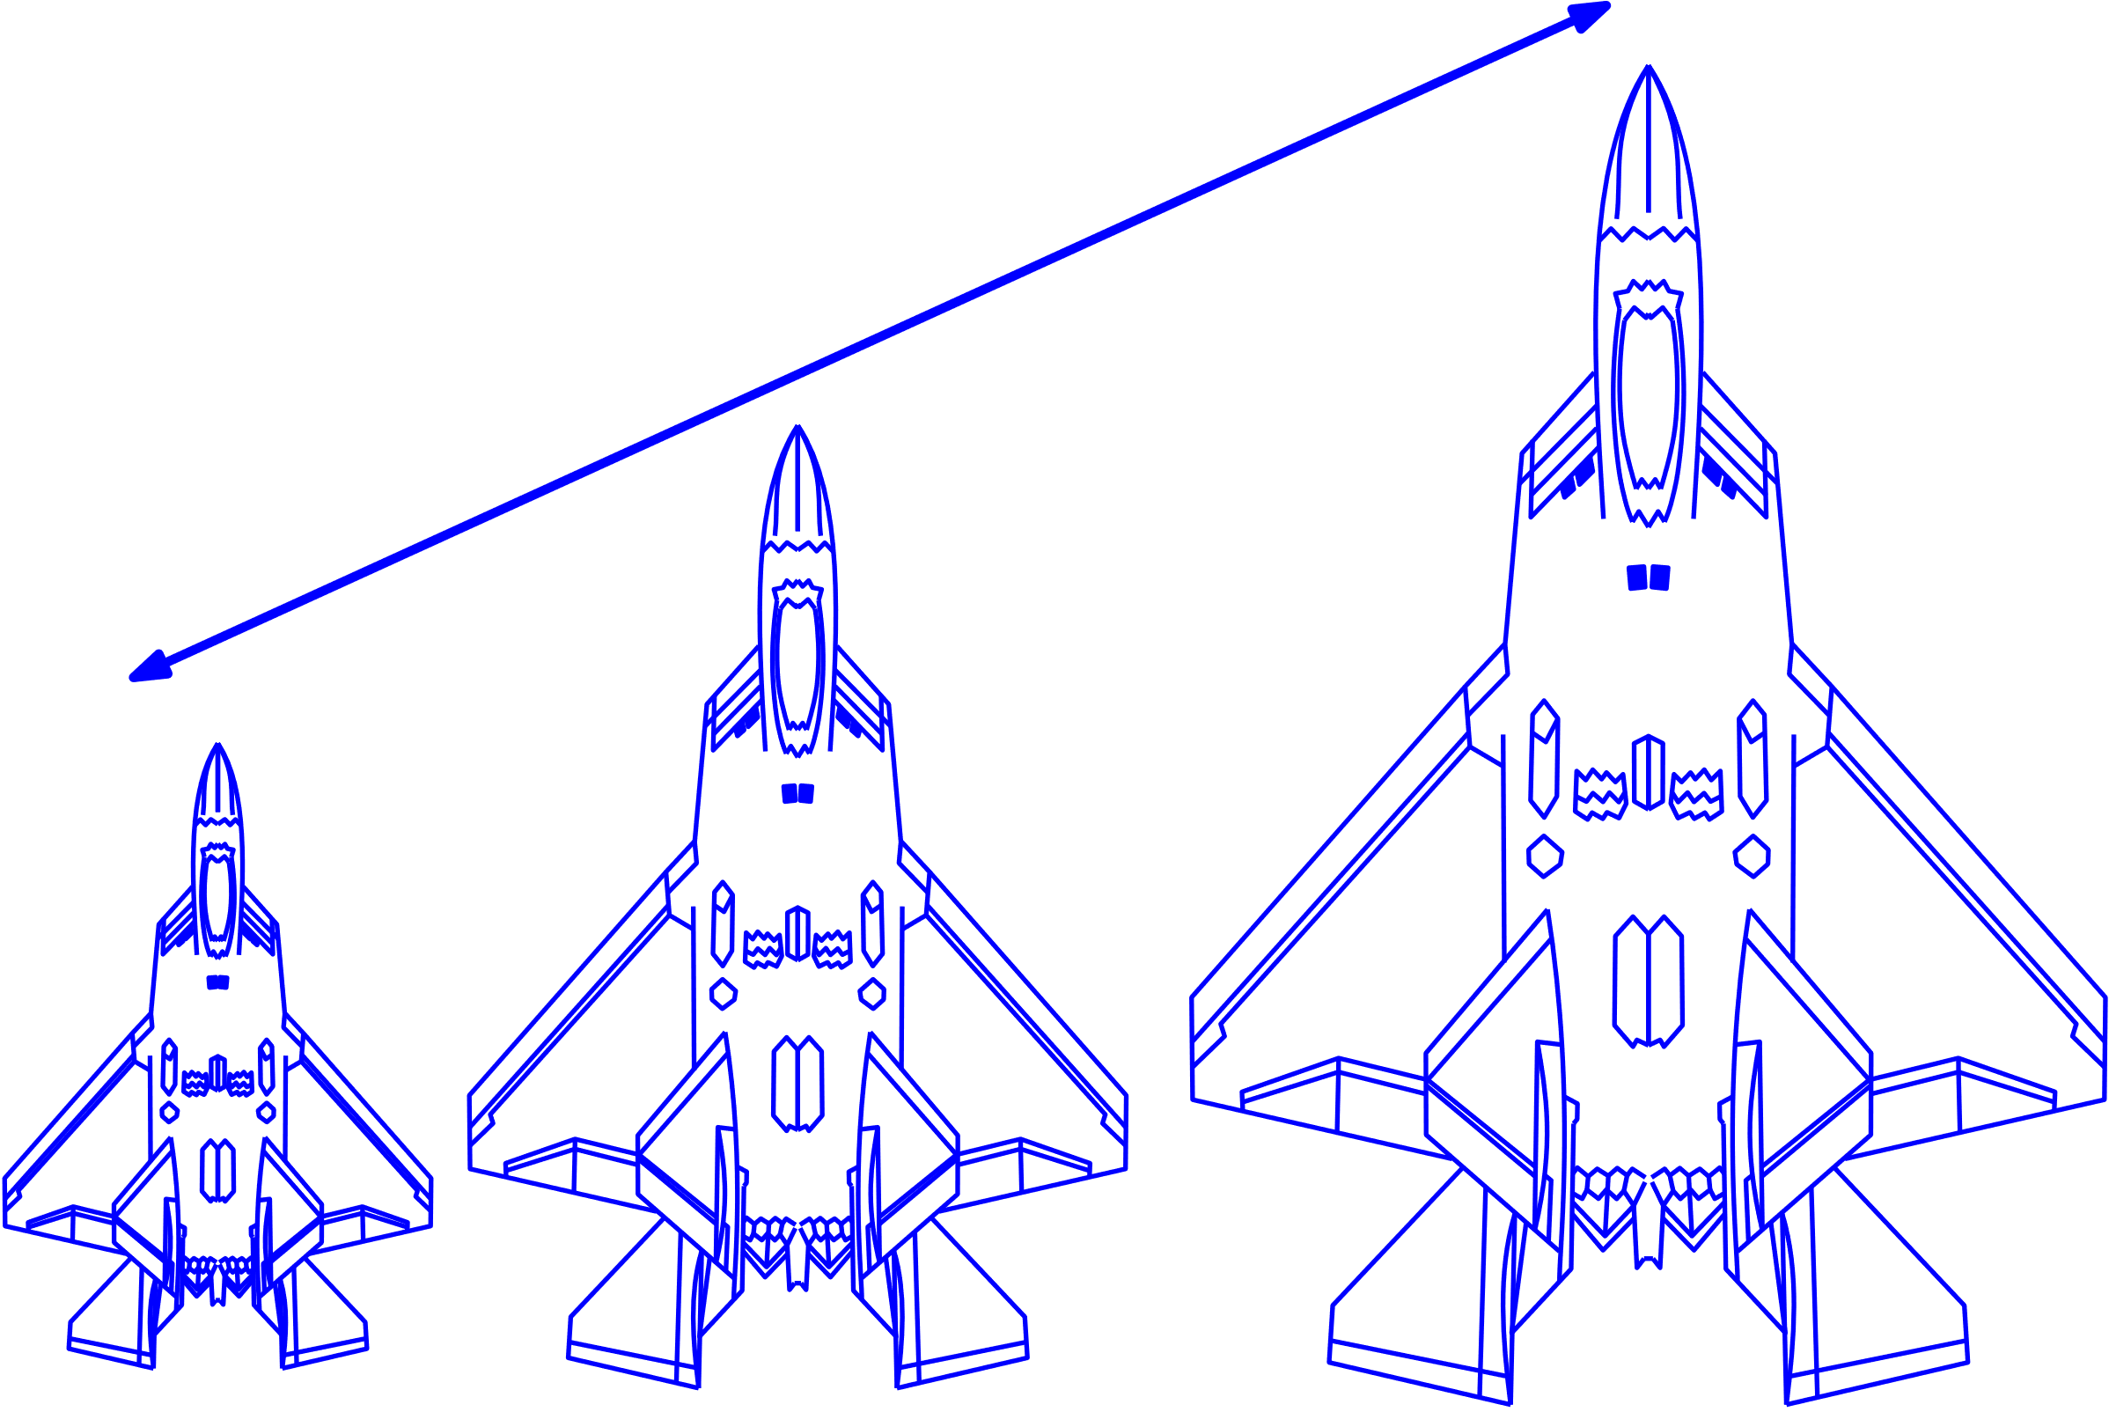
The Two Sides of Conceptual Design
Configuration
Sizing
“What kind of airplane should we draw?”
“How big should we draw it?”
Note: this decomposition doesn’t just apply to airplanes!

Slide 4
The Two Sides of Conceptual Design
Configuration
Sizing
Solution topology (the “what”)
Qualitative-ish
Key Questions:
Where/how many lifting surfaces?
Propulsion type, energy source?
Rough internal layout
Material selection for primary structure
CONOPS
Solution scale (the “how much”)
Quantitative
Key Questions:
Size, Weight, and Power (“SWaP”)
System and subsystem-level
Cost
Performance (range, endurance, payload)
“Does the design close?”
Notes:
* So: which one do you think we do first?

Slide 5
The Two Sides of Conceptual Design
Configuration
Sizing
Driven by:
Creativity
Requires intuitive understanding of the problem space
Identifying synergies
Main tool: a sketch
Note: not CAD!
Decisions are usually discrete
Driven by:
First-principles physics – what does Nature allow?
Requires mathematical models
Sometimes: empirical/historical models
Main tool: napkin math
Decisions are usually continuous
Both: driven by requirements (intended purpose, laws, safety, market, emissions, etc.)
Notes:
* So: which one do you think we do first?

Slide 6
Which one do you think we do first?

Slide 7
Iterative Configuration and Sizing
Usually both! Why?
To lock down the sizing:
Need to know the configuration!
To choose a configuration:
Need to compare:
Best version of Configuration A
Best version of Configuration B
Need to build design space intuition so we can generate better configurations.
May need to push back on requirements, if no design closes
Two Parts of Conceptual Aircraft Design
Sizing
Configuration
How big is the airplane?
What does the airplane look like?
Example:
Aluminum or carbon fiber fuselage?

Slide 8
Learning Configuration and Sizing
Configuration
Sizing
Creativity, design space intuition, pattern recognition
Driven by a person
Modeling, calculation
Often driven by a computer
Comes with experience!
This is the point of taking 16.82/821, Unified Flight Competition, design teams!
Easier to teach, and today’s focus! ☺

Slide 9
An Overview of Sizing
“To [others], our process of aircraft sizing seems backwards. Most people would assume that we draw a new aircraft design and then determine how far it goes.
We do it the other way around. We know how far it goes – it goes as far as the requirements say it goes. What we do not know… is how big to draw it.”
- Dan Raymer, Aircraft Design
Notes:
Quote from Raymer
<read>
One of the things I like about this quote is that it emphasizes that sizing (and really all of aircraft design) is driven by requirements. As the requirements change, the design does too – so sizing is a dynamic process.
Another thing: forward design vs. inverse design:
Engineering education often focuses on forward design (“analysis” or “simulation”): “here’s a design, figure out how good it does?”
In reality, we often need to turn the problem around and work with the inverse problem (“design” or “optimization”): “This is how good it needs to be, what does the design look like?”

Slide 10
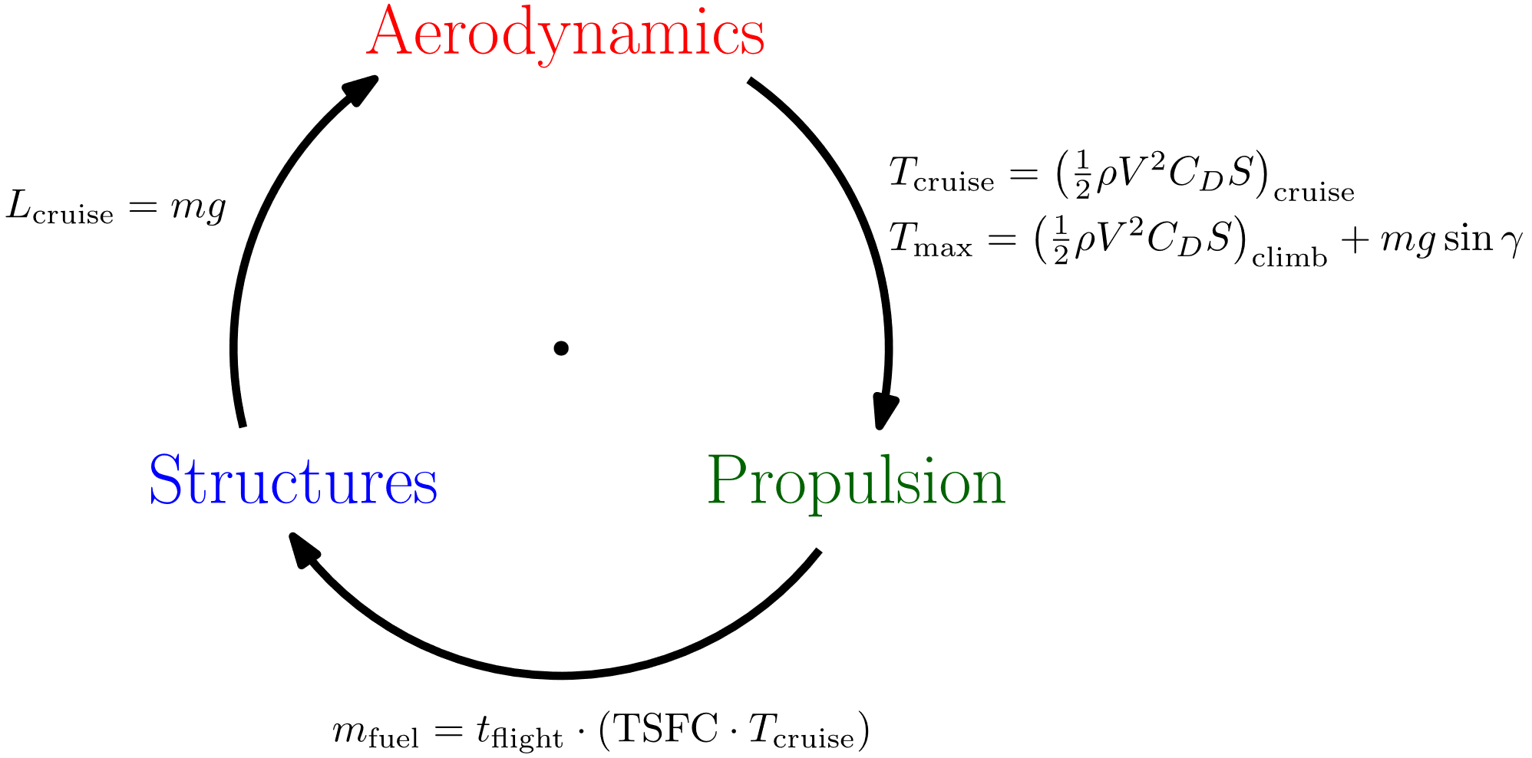
Concepts: Design Closure
What does it mean for the aircraft design to “close”?
Basically, it’s physically feasible. Simplified model:

Slide 11
Closure is Not Enough
Design closure is the bare minimum expectation
Many (but not all) closure problems get alleviated if you draw the airplane bigger for a given payload.
Why?
Don’t want to do this unnecessarily:
Program risk, cost, complexity
Many designs close! Which one do we want?
The minimum viable airplane that meets requirements, plus margin.
(though a few eVTOL pitches make you wonder…)
“The perfect racing car crosses the finish line first and subsequently falls into its component parts.”
- Ferdinand Porsche
(plus margin!)

Slide 12
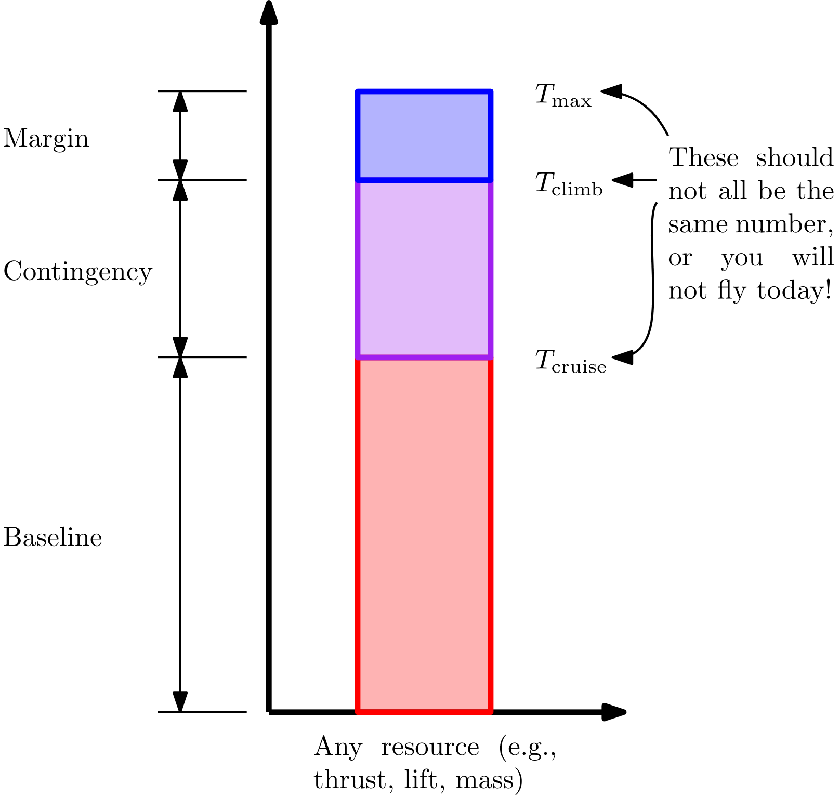
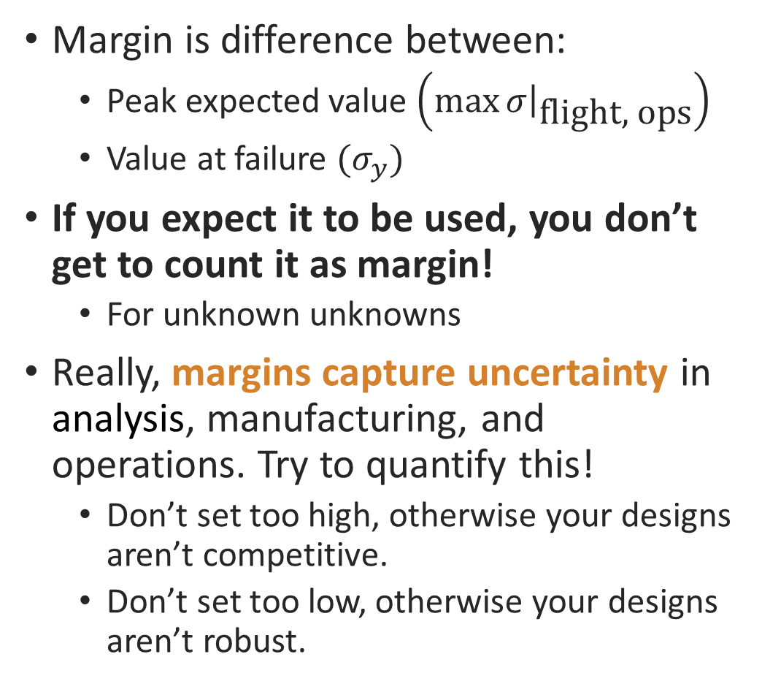
Concepts: Margin
Margin is difference between:
Peak expected value $\left({\left.\max{σ}\right|}_{\text{flight}\text{, }\text{ops}}\right)$
Value at failure $(σ_{y})$
If you expect it to be used, you don’t get to count it as margin!
For unknown unknowns
Really, margins capture uncertainty in analysis, manufacturing, and operations. Try to quantify this!
Don’t set too high, otherwise your designs aren’t competitive.
Don’t set too low, otherwise your designs aren’t robust.

Slide 13
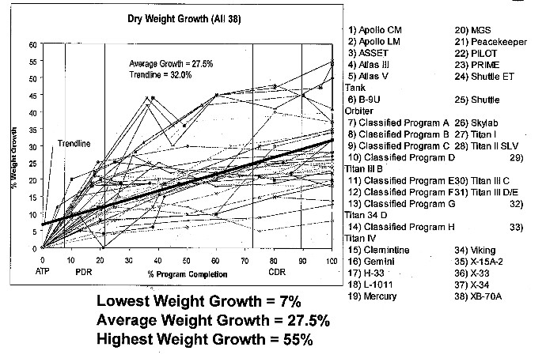
How Much Margin?
Really, depends strongly on modeling accuracy (and consequence of exceeding). But, rough rules of thumb at conceptual stage:
Weight: 15%-35%
Thrust: 10%-30%
Drag: 5%-20%
Energy: 5%-20%
Stress: 50%-100%
Schedule: 15%
Cost: 25-50%
Historical weight growth for spacecraft/airplanes. NASA TN 0-6349, via Crawley.

Slide 14
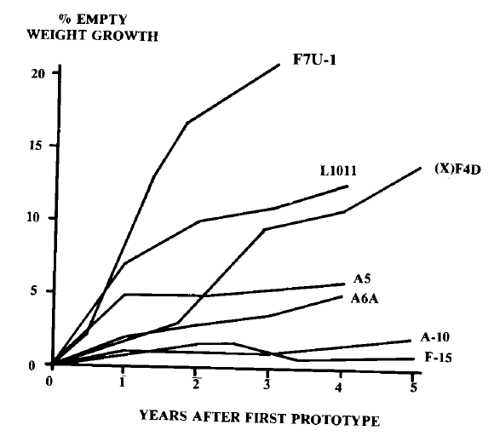
How Much Margin?
Really, depends strongly on modeling accuracy (and consequence of exceeding). But, rough rules of thumb at conceptual stage:
Weight: 15%-35%
Thrust: 10%-30%
Drag: 5%-20%
Energy: 5%-20%
Stress: 50%-100%
Schedule: 15%
Cost: 25-50%
Illustration of weight growth even after first flight! From Raymer, Aircraft Design.

Slide 15
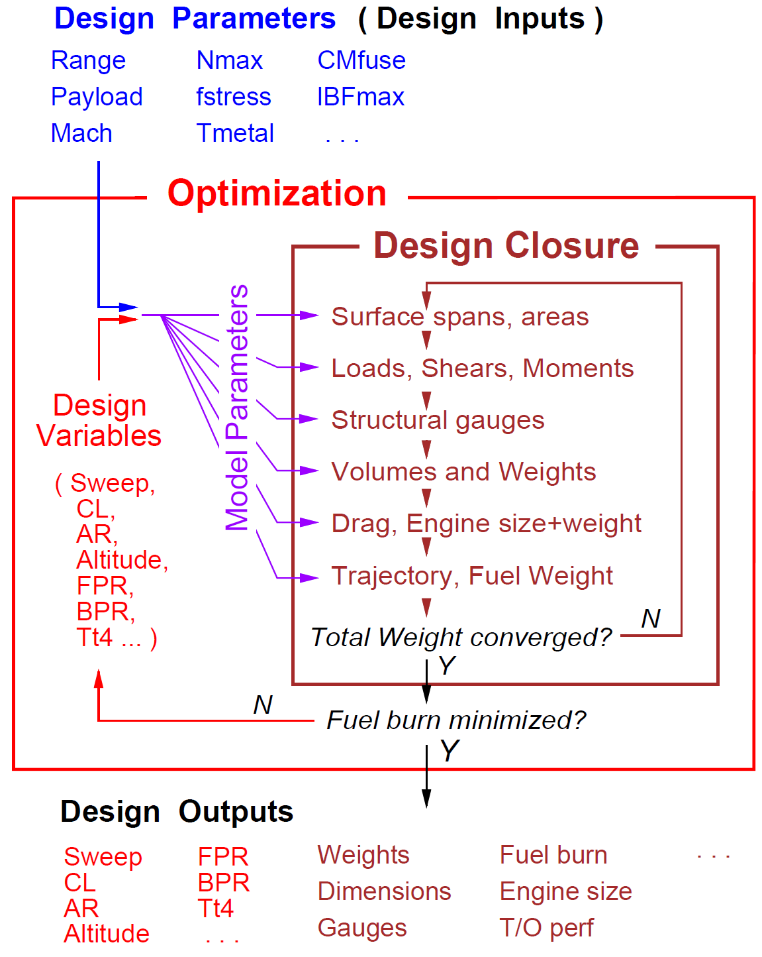
Why Optimize?
There are many possible aircraft that close!
How do we pick which one is the “minimum viable airplane that meets requirements, plus margin?”
Design optimization
Illustration of design closure. From Drela, “Design Drivers of Energy-Efficient Transport Aircraft”, 2011. SAE Int’l J. of Aerospace.

Slide 16
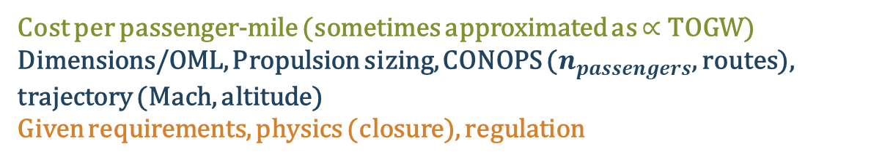
Why Optimize?
Sizing is fundamentally an optimization problem. It’s often helpful to explicitly state it as such:
Three key parts:
Objective function
The metric you are minimizing
Variables
Which “knobs” do you have to work with?
Sets the dimensionality of the design space
Constraints
Limits the design space to a feasible space
Equality constraints are a projection (dimensionality reduction)
Can be active or inactive
Advice: write this out explicitly!
Problem formulation is by far the most important step of design optimization
Typical transport aircraft
Minimize:
With respect to:
Subject to:
Cost per passenger-mile (sometimes approximated as $∝$ TOGW)
Dimensions/OML, Propulsion sizing, CONOPS ($n_{passengers}$, routes), trajectory (Mach, altitude) Given requirements, physics (closure), regulation
Notes:
Constraints:
Constraints tend to be the most interesting part of a design optimization problem
Can anyone think of examples of constraints?
Requirements
Physics
Active, tight, driving -> synonyms
Inactive constraint:
The wing spar must fit inside the airfoil
Wing spar is gauge-limited due to buckling considerations, doesn’t hit this constraint
If constraints aren’t active, you likely don’t need to spend much time refining that constraint
Be sure to spend a lot of time figuring out what the right question to ask is
* The same problem with two different formulations (change of variables, transformation of design space, etc.) can take orders of magnitude more time to solve*

Slide 17
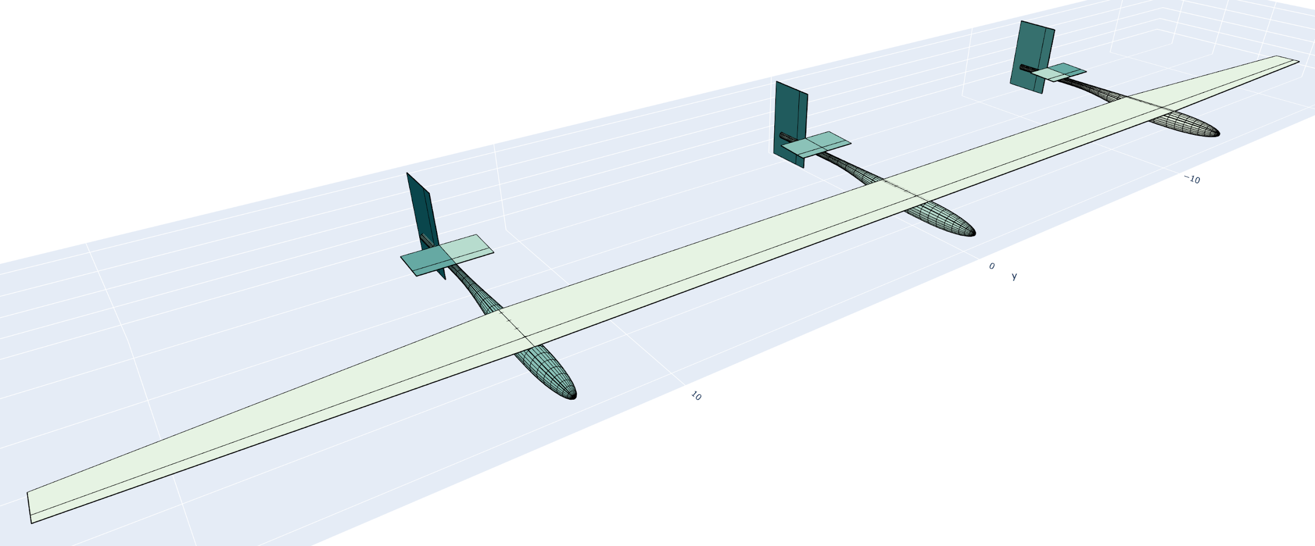
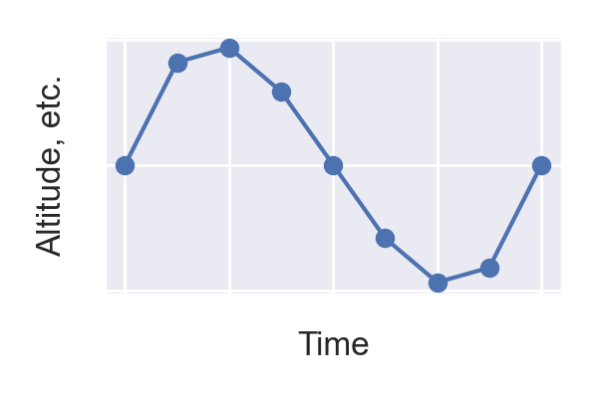
Combined Vehicle and Mission Optimization
Simultaneously optimizing...
Aircraft Design
Mission Profile
Variables
Hundreds, including:
wing geom. (two-sect.),
tail geom. (one-sect.),
boom geom.,
propeller params.,
battery cap.,
solar panel area,
motor rated power,
wing internal struct.
Parameters
payload mass
# of booms
battery spec. energy
margins
Variables
Thousands, including:
altitude
airspeed
throttle, ctrl. surf. inputs
Parameters
min. altitude
wind speed dist.
latitude
day of year
Objective Function
Minimize wingspan
Constraints
Physics models
~150 models, ~4,000 constraints
Notes:
Both:
What you fly
Fairly obvious that this matters
How you fly
A little less obvious
Particularly over the course of a 24h period
Altitude cycling
Use altitude as a battery
Ascend during day, descend during evening
For some missions, this isn’t significant; for others, it will be very significant
Different airspeeds at day and night
Can anyone think of roughly the best V-speeds to fly at during day and night?
Day:
Roughly best climb speed
Night:
Minimum sink speed

Slide 18

So we can just plug this into an optimizer and hit the button?

Slide 19
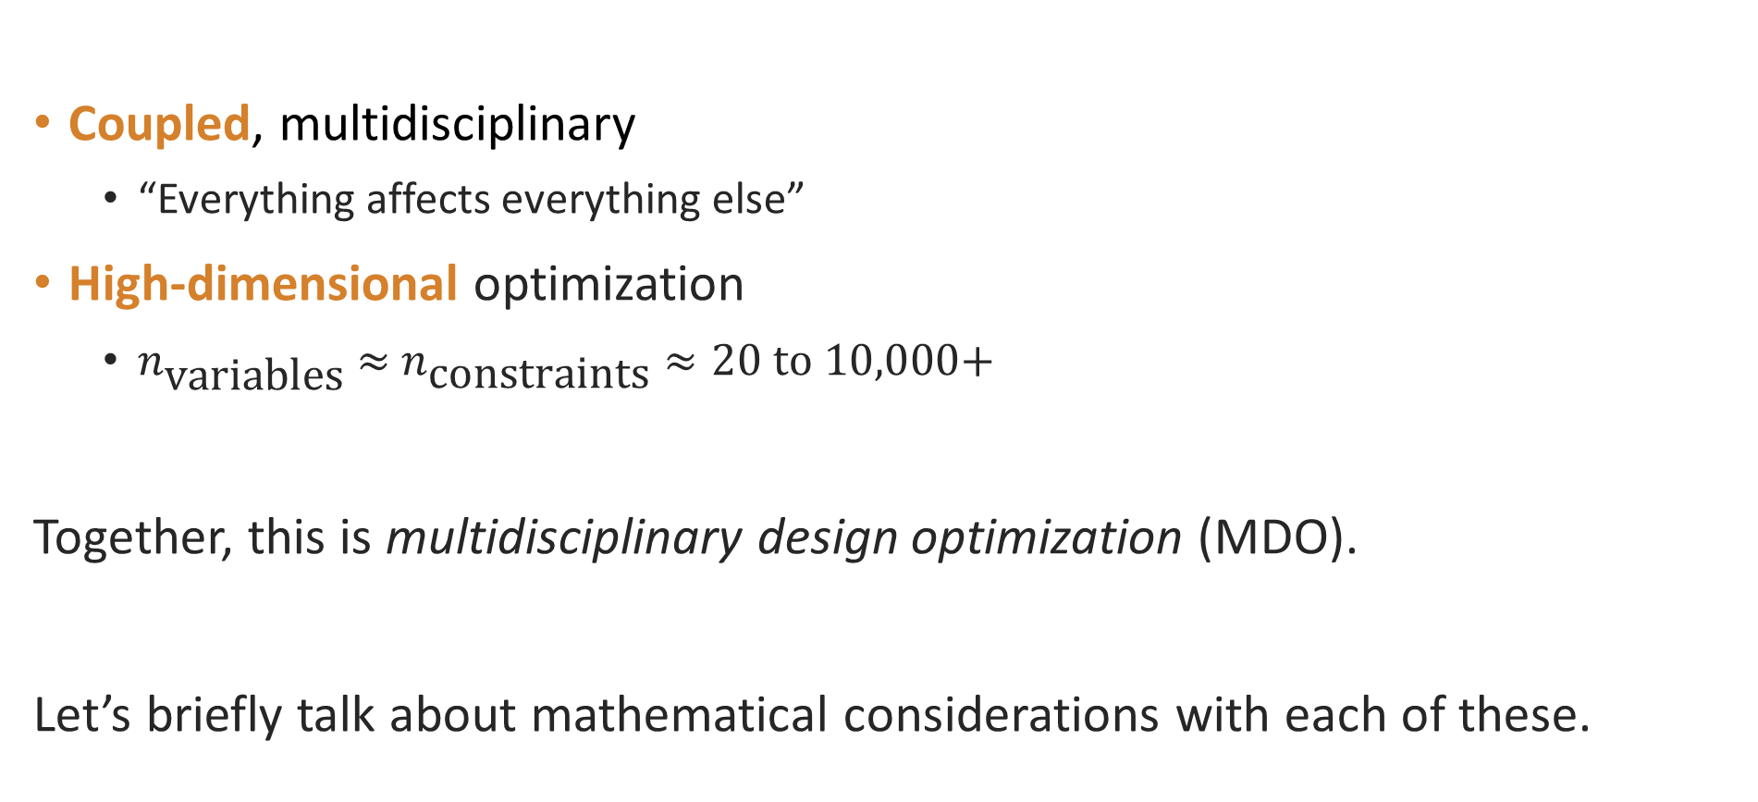
Key Challenges in Aircraft Design Optimization
Coupled, multidisciplinary
“Everything affects everything else”
High-dimensional optimization
$n_{\text{variables}} \text{≈} n_{\text{constraints}}≈20 \text{to}\text{ 10,000+}$
Together, this is multidisciplinary design optimization (MDO).
Let’s briefly talk about mathematical considerations with each of these.
Typical Disciplines
Aerodynamics
Structures
Propulsion
Stability & Control
Trajectory/Dynamics
Mission-specific requirements
…
Weights
Power Systems
Notes:
Time dependence
This solar airplane problem is inherently unsteady
Day/Night energy injections into system
Differing power requirements during day/night
Science value and wind fluctuations over day
Ascent as a sizing case
Nearly all aircraft design problems are unsteady in some sense
787 Dreamliner has a fuel mass fraction of 44%
Briefly going to talk about key challenges in aerospace design optimization:
Just surface level
Not all of you are interested in design optimization, that’s okay
Goal is to help you understand what kinds of problems are tractable, and what kinds of problems aren’t

Slide 20
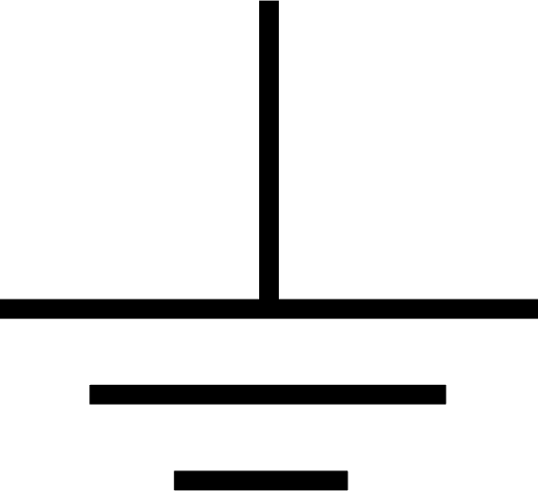
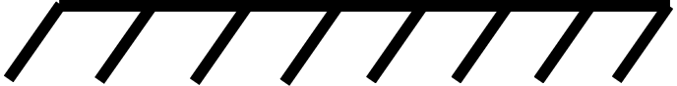
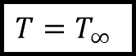
Coupled Problems: Why is aircraft design so coupled?
Typical engineering systems:
On free-flying aerospace systems:
Nowhere to dump conserved quantities: mass, momentum, energy, heat, charge, etc.
Each force and moment must be perfectly balanced with all others
All subsystems must be designed together
$$T=T_{∞}$$
Notes:
Coupling is not unique to aerospace design, but I’m gonna make the claim that it’s far more of a problem in aerospace than in other engineering applications.
Nowhere to dump conserved quantities (momentum, energy, heat, charge, etc.) on an airplane
If you’re designing a cantilever beam, there’s a fixed support
If you’re designing a circuit, there’s a ground
If you’re designing an engine, there’s some place for heat rejection
Aerospace systems have nothing to “push off of”
Each force and moment must be perfectly balanced with another

Slide 21
Coupled Problems: The Closure Problem
The Closure Problem
Driving dependencies (just to 1st order!)
Aerodynamics
Power Systems
Structures
Iterative closure scales very poorly
We need to solve for closure implicitly - in one shot!
Weights
Geometry
Propulsion
Trajectory / Dynamics
Stability & Control
Notes:
Nowhere to dump conserved quantities (momentum, energy, heat, charge, etc.) on an airplane
If you’re designing a cantilever beam, there’s a fixed support
If you’re designing a circuit, there’s a ground
If you’re designing an engine, there’s some place for heat rejection
Aerospace systems have nothing to “push off of”
Each force and moment must be perfectly balanced with another

Slide 22
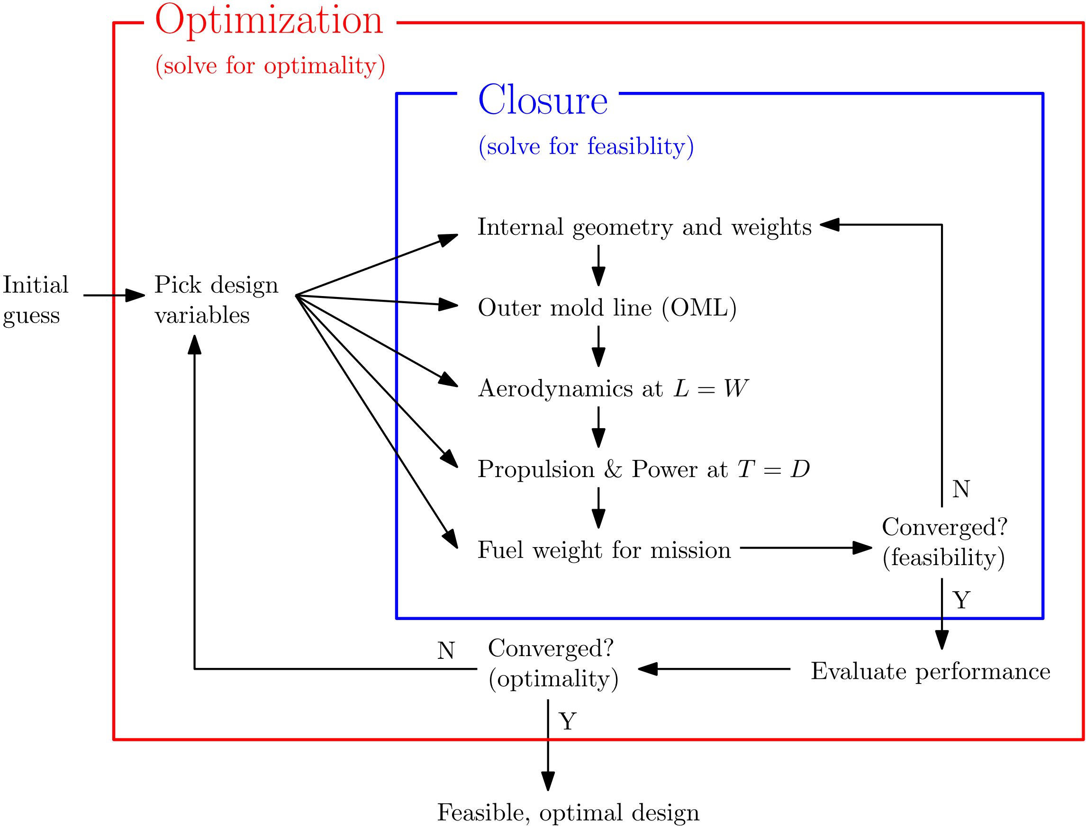
Coupled Problems: Approaches
Traditional: nested closure and optimization

Slide 23
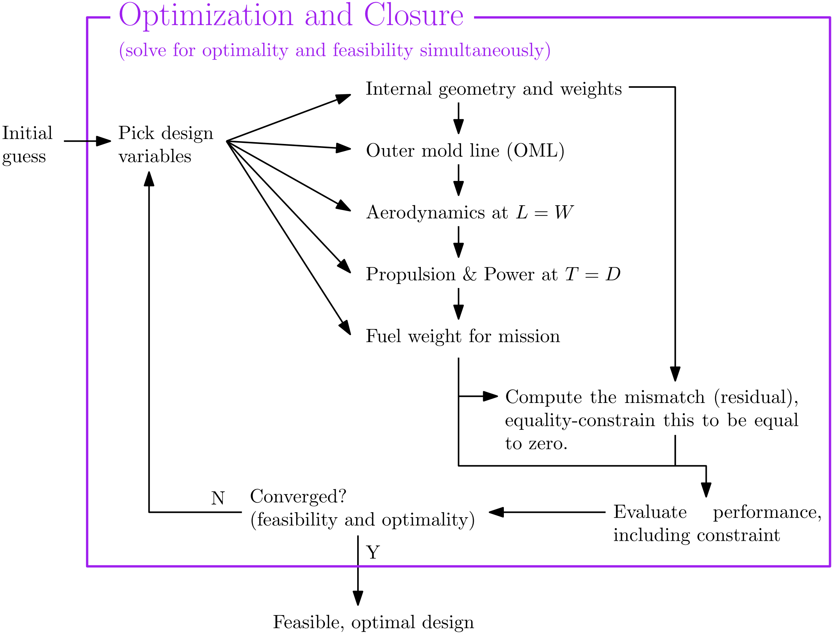
Coupled Problems: Approaches
More modern approach: simultaneous analysis and design (SAND)

Slide 24
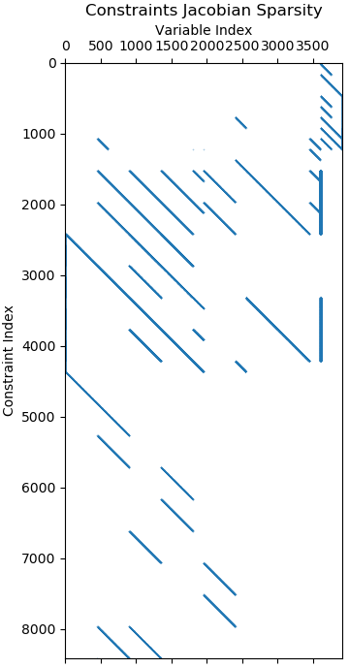
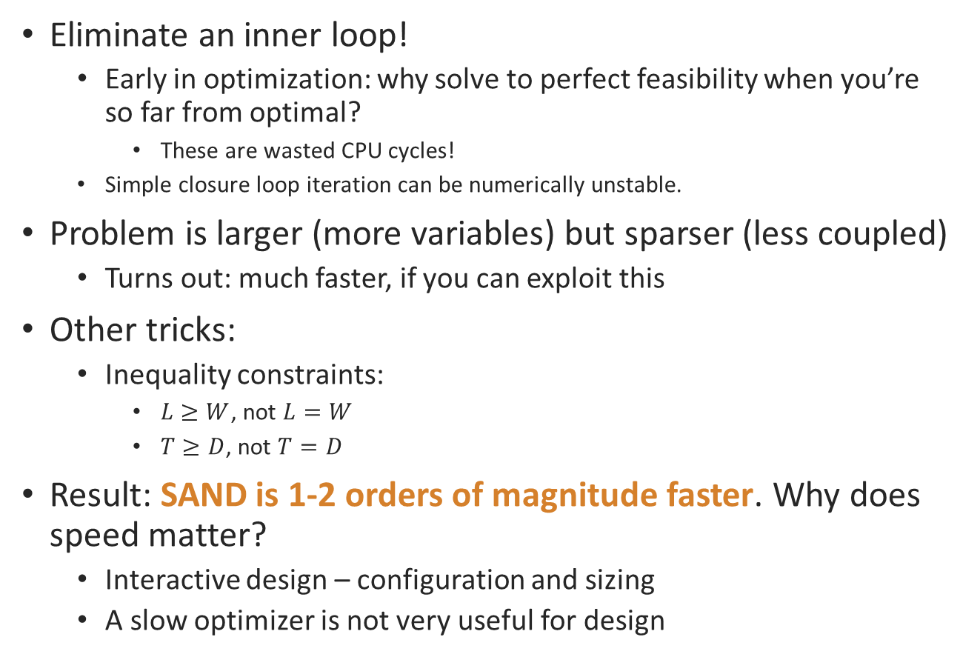
Coupled Problems: Is SAND worth it?
Eliminate an inner loop!
Early in optimization: why solve to perfect feasibility when you’re so far from optimal?
These are wasted CPU cycles!
Simple closure loop iteration can be numerically unstable.
Problem is larger (more variables) but sparser (less coupled)
Turns out: much faster, if you can exploit this
Other tricks:
Inequality constraints:
$L≥W$, not $L=W$
$T≥D$, not $T=D$
Result: SAND is 1-2 orders of magnitude faster. Why does speed matter?
Interactive design – configuration and sizing
A slow optimizer is not very useful for design
Notes:
So, note that now, our variables aren’t necessarily things we would consider to be “independent” – we have both structural sizing and weight!
Shifting our physics models into constraints
Use inequalities where possible
Limiting our cross-discipline couplings to just a few points
Figure on the right
Example of the jacobian of constraints with respect to design variables
Each “row” is a constraint, and the shaded regions show which variables are being linked by those constraints

Slide 25
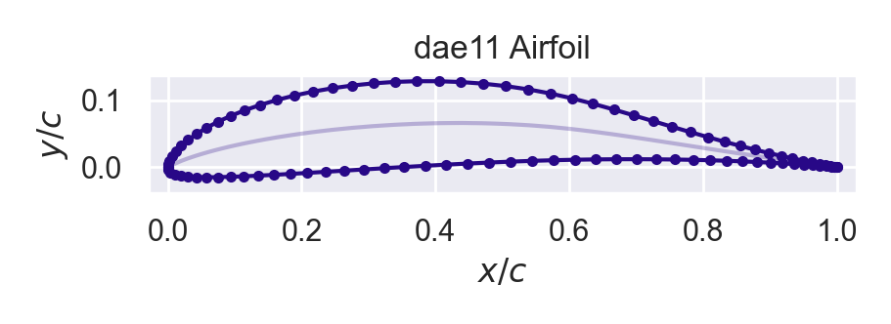
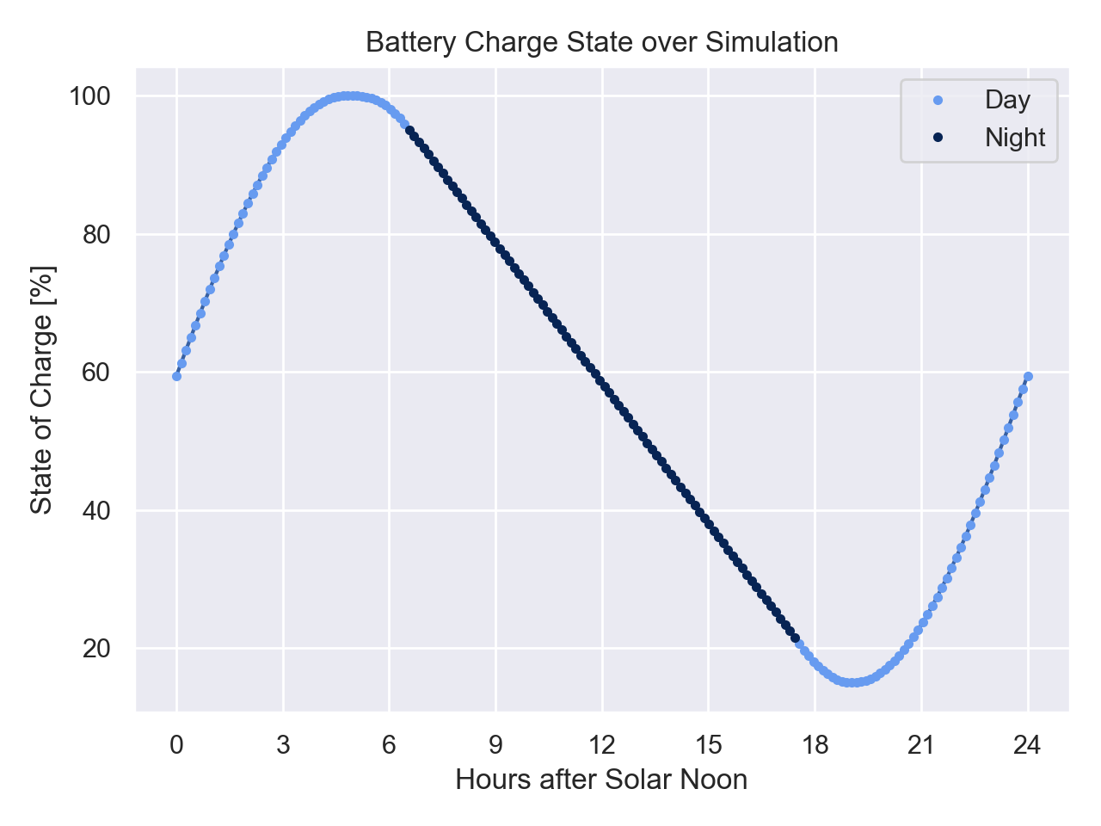
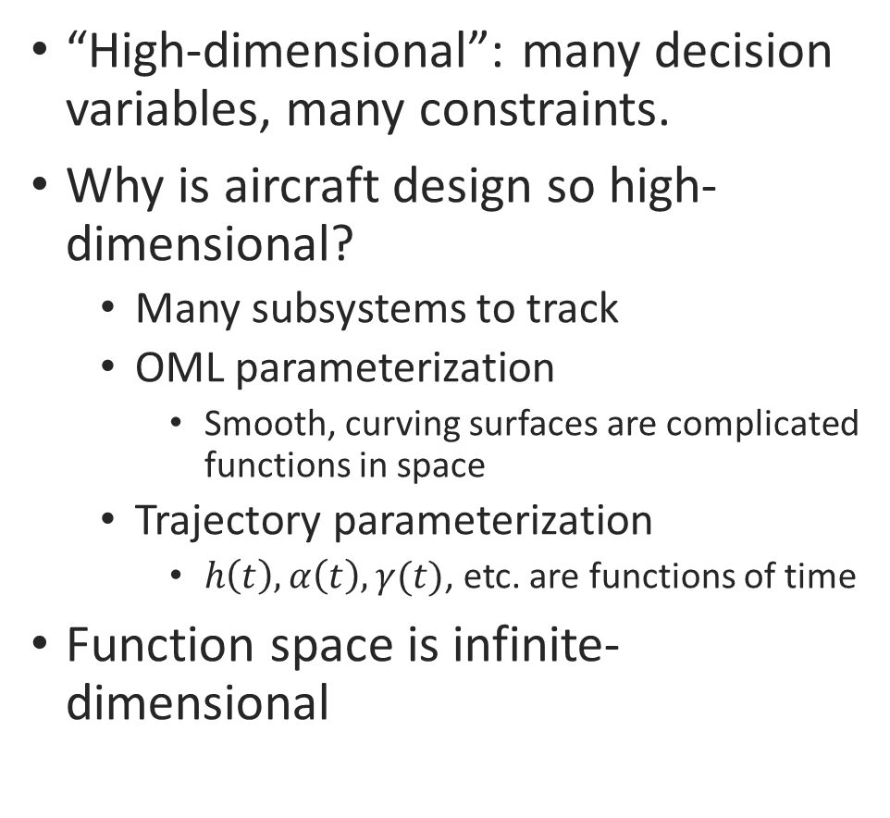
High Dimensionality: Why is aircraft design so high-dimensional?
“High-dimensional”: many decision variables, many constraints.
Why is aircraft design so high-dimensional?
Many subsystems to track
OML parameterization
Smooth, curving surfaces are complicated functions in space
Trajectory parameterization
$h\left(t\right), α\left(t\right), γ(t)$, etc. are functions of time
Function space is infinite-dimensional

Slide 26
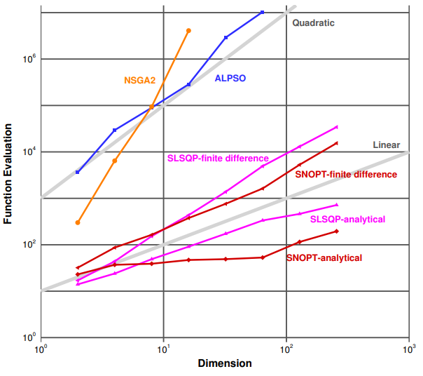
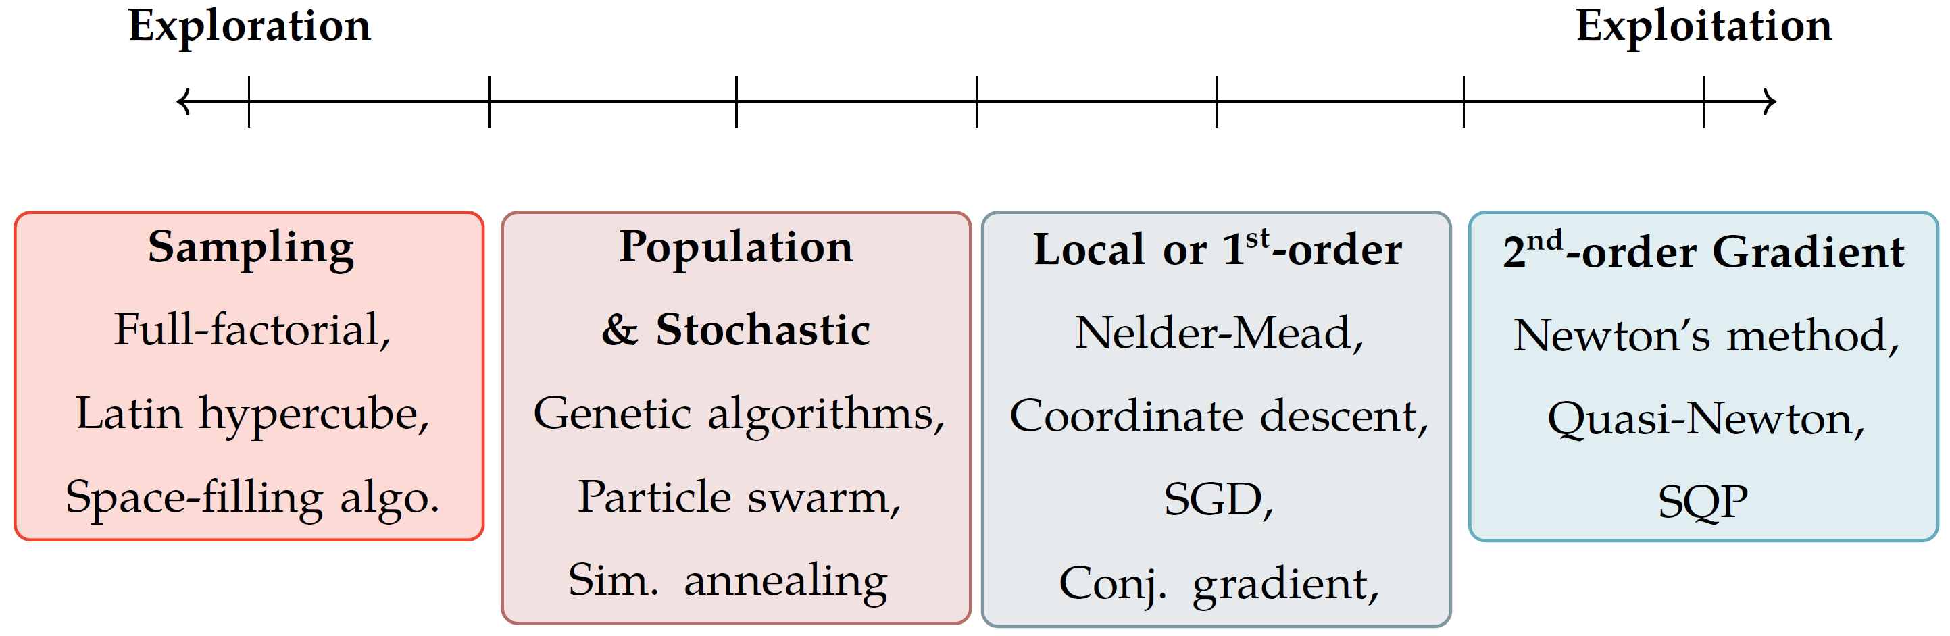
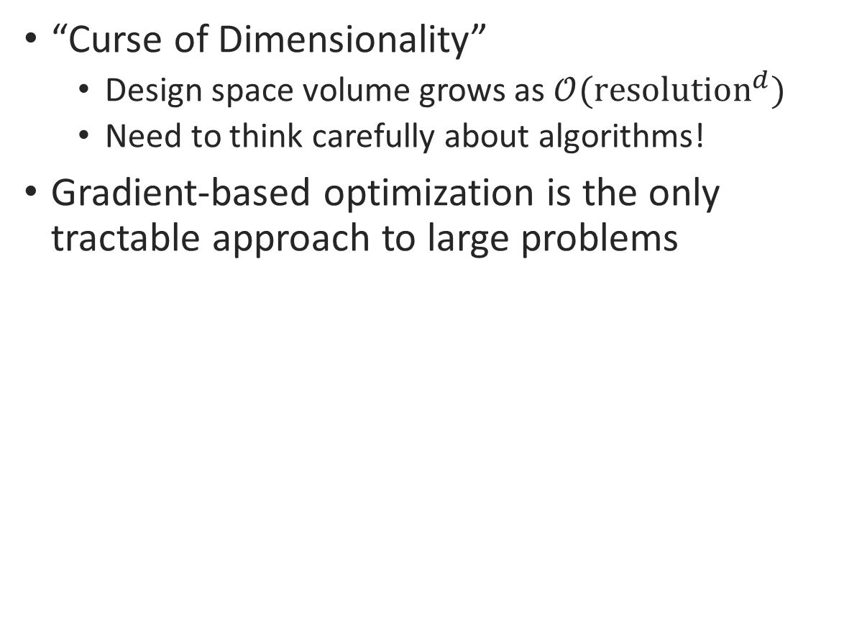
High Dimensionality: Implications for Optimization
“Curse of Dimensionality”
Design space volume grows as $𝒪({\text{resolution}}^{d})$
Need to think carefully about algorithms!
Gradient-based optimization is the only tractable approach to large problems
Dimensionality vs. Computational Cost
Figure reproduced from J. Martins, 2013 pres., “A Very Short Course on Multidisciplinary Design Optimization”
Notes:
Curse of Dimensionality
Imagine an n-dimensional problem, and assume each variable has three settings – low, med, high.
The number of possible designs grows like 3^n – it runs away from us extremely quickly
Clearly sweeping whole the space is out of the question.
Gradient-based
It turns out that gradient-based optimization is really the only tractable approach here
Second-order
So we look at both the Jacobian and Hessian
Automatic differentiation
On chart: analytical derivatives (similar to automatic differentiation) scale sublinearly with dimensionality
With efficient derivatives, you can actually solve n-dimensional optimization problems in fewer than n function evaluations
Something interesting to think about
“Automatic” part vs. analytical derivatives
You don’t have to think about these derivatives
It all happens under the hood
Kind of a theme here: we’re trying to abstract away all the optimization numerics so that you can focus on:
Asking the right questions
(equally importantly) Writing the right physics models

Slide 27
High Dimensionality: Gradient-Based Bottlenecks

Slide 28
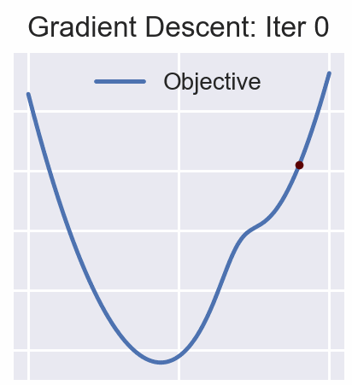
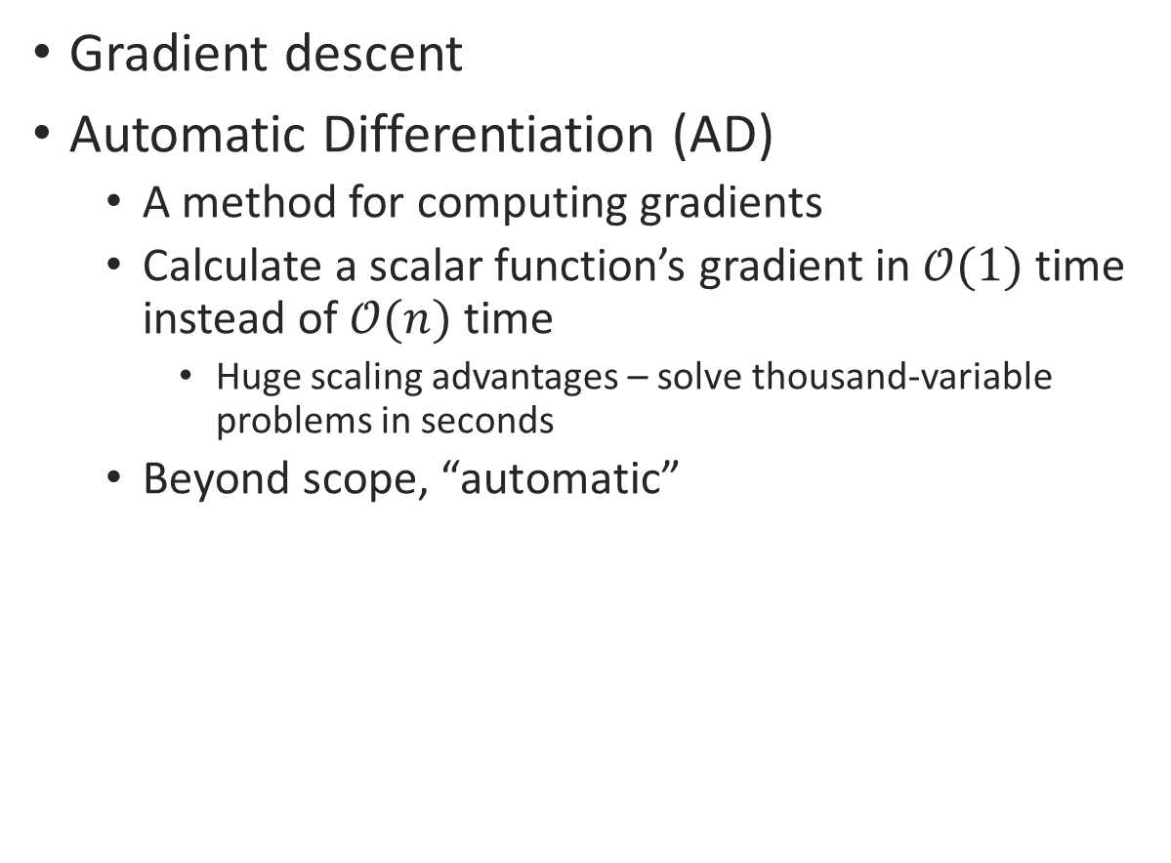
Large-Scale Optimization
Gradient descent
Automatic Differentiation (AD)
A method for computing gradients
Calculate a scalar function’s gradient in $𝒪(1)$ time instead of $𝒪(n)$ time
Huge scaling advantages – solve thousand-variable problems in seconds
Beyond scope, “automatic”
Notes:
Curse of Dimensionality
Imagine an n-dimensional problem, and assume each variable has three settings – low, med, high.
The number of possible designs grows like 3^n – it runs away from us extremely quickly
Clearly sweeping whole the space is out of the question.
Gradient-based
It turns out that gradient-based optimization is really the only tractable approach here
Second-order
So we look at both the Jacobian and Hessian
Automatic differentiation
On chart: analytical derivatives (similar to automatic differentiation) scale sublinearly with dimensionality
With efficient derivatives, you can actually solve n-dimensional optimization problems in fewer than n function evaluations
Something interesting to think about
“Automatic” part vs. analytical derivatives
You don’t have to think about these derivatives
It all happens under the hood
Kind of a theme here: we’re trying to abstract away all the optimization numerics so that you can focus on:
Asking the right questions
(equally importantly) Writing the right physics models

Slide 29
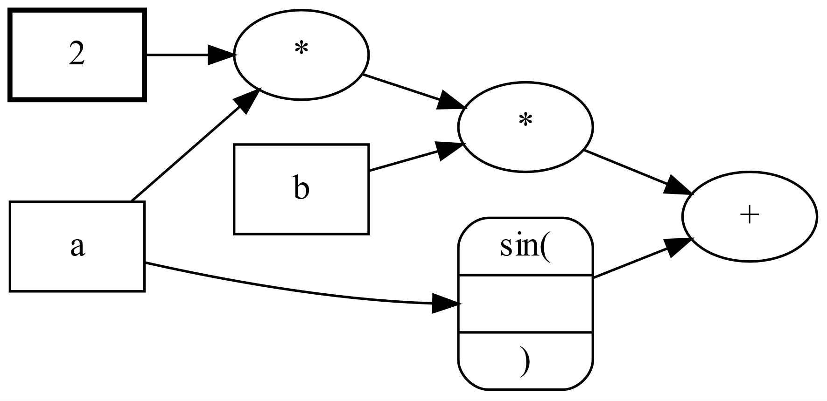
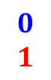
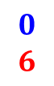
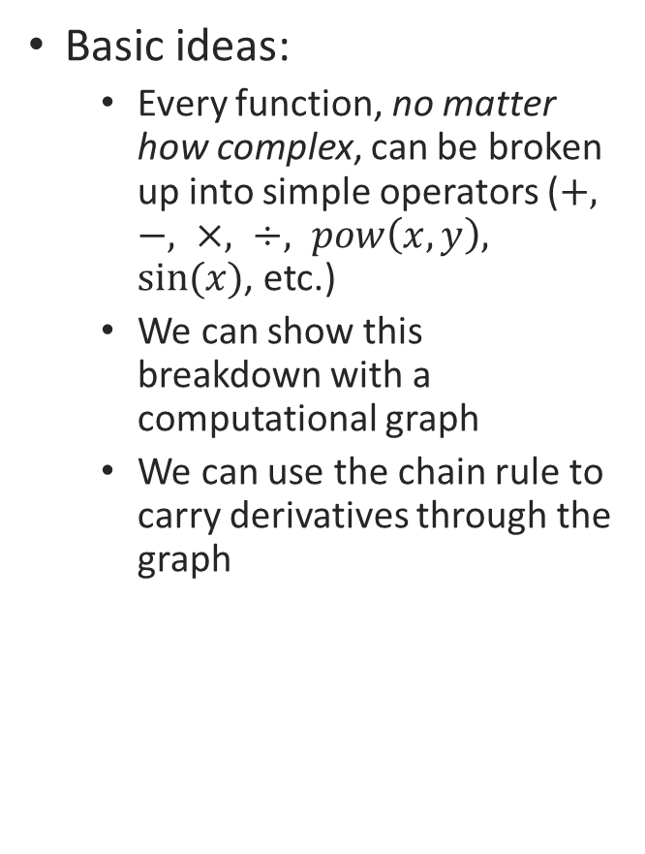
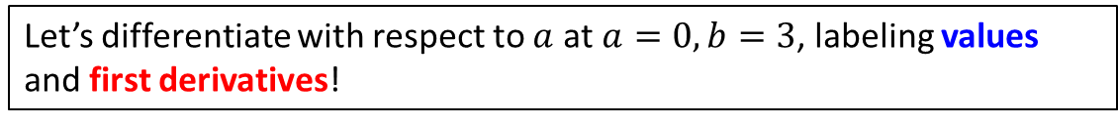
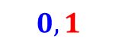

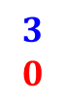
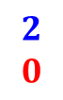
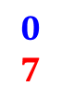
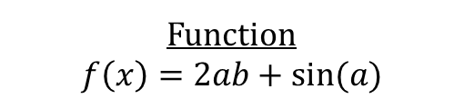

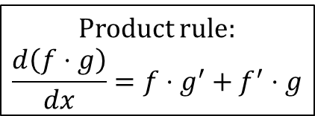
New Optimization Strategies: How does AD work
Basic ideas:
Every function, no matter how complex, can be broken up into simple operators ($+, −, ×, ÷, pow\left(x,y\right), sin⁡(x)$, etc.)
We can show this breakdown with a computational graph
We can use the chain rule to carry derivatives through the graph
Function
$$f\left(x\right)=2ab+sin⁡(a)$$
Computational Graph
Product rule:
$$\frac{d\left(f⋅g\right)}{dx}=f⋅g^{′}+f^{′}⋅g$$
$$2$$
$$0$$
$$0$$
$$2$$
$$0$$
$$6$$
$$3$$
$$0$$
$$0$$
$$7$$
$$0$$
$$1$$
$$0,1$$
Two flavors of AD
Forward mode
Cost scales with # of inputs
Reverse mode
Cost scales with # of outputs
Let’s differentiate with respect to $a$ at $a=0, b=3$, labeling values and first derivatives!
Notes:
* Would be useful to have an eng example (how about ½ rho v sqared), lift equation?

Slide 30
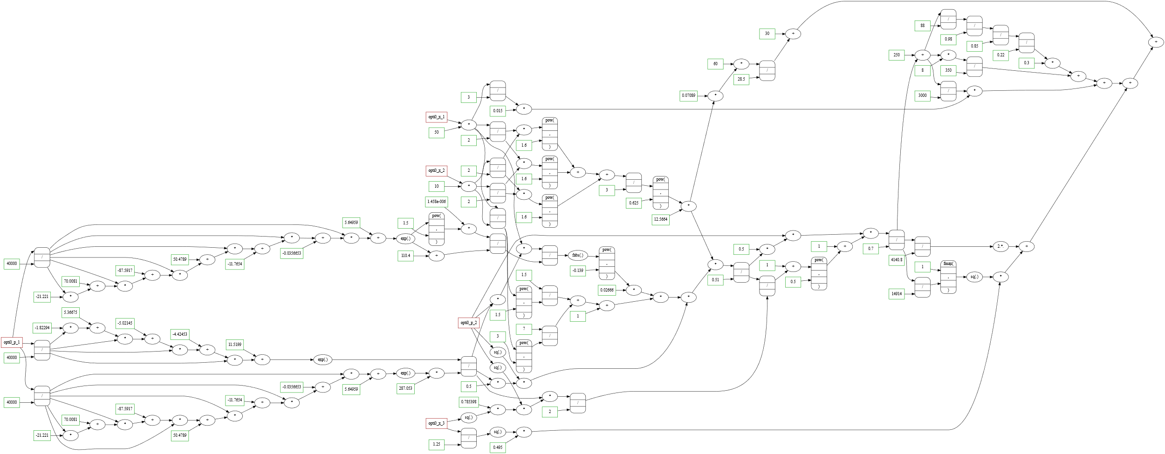
New Optimization Strategies: How does AD work
You can make a differentiable graph for ANY function!
Static vs. dynamic computational graphs
“tape”
Control flow (if/then, for loops)
Forward vs. reverse mode
Computational graph of mass calculation for a solar-powered blimp
Notes:
Might not need to convince them of this, backup?
Show firefly, show the WHOLE graph (then blow it up)

Slide 31
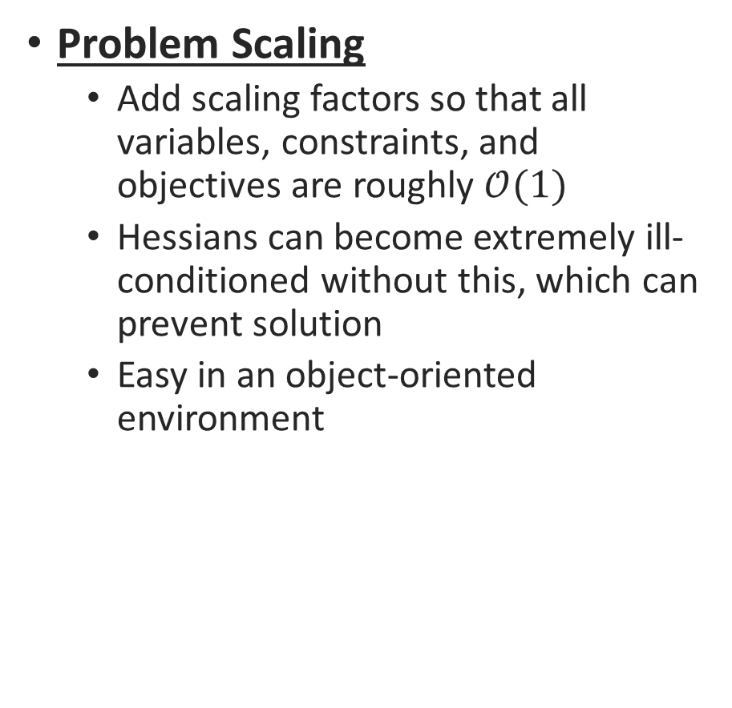
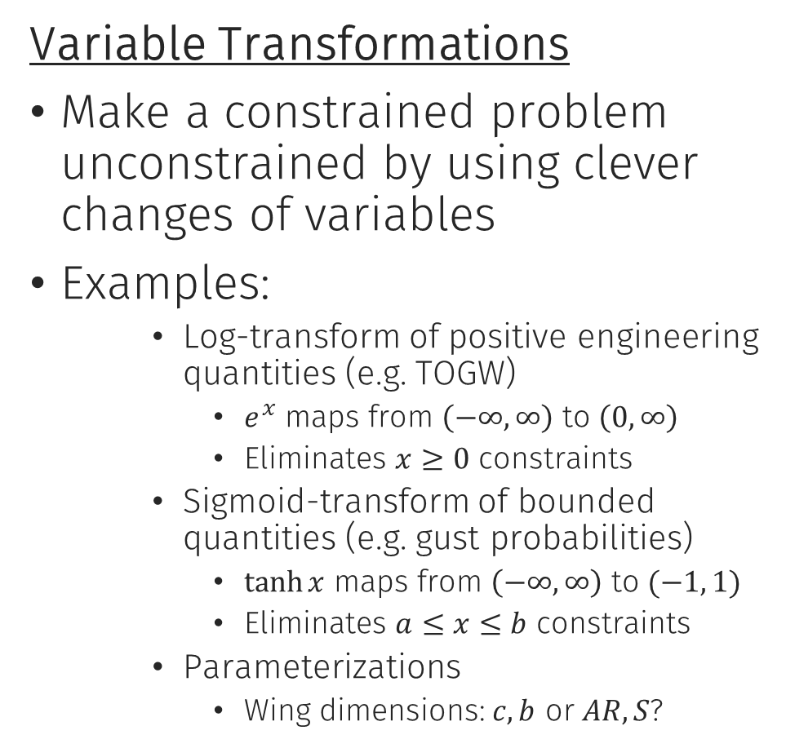
Large Scale Optimization
Problem Scaling
Add scaling factors so that all variables, constraints, and objectives are roughly $𝒪(1)$
Hessians can become extremely ill-conditioned without this, which can prevent solution
Easy in an object-oriented environment
Variable Transformations
Make a constrained problem unconstrained by using clever changes of variables
Examples:
Log-transform of positive engineering quantities (e.g. TOGW)
$e^{x}$ maps from $\left(−∞, ∞\right)$ to $\left(0, ∞\right)$
Eliminates $x≥0$ constraints
Sigmoid-transform of bounded quantities (e.g. gust probabilities)
$\tanh{x}$ maps from $\left(−∞, ∞\right)$ to $(−1, 1)$
Eliminates $a≤x≤b$ constraints
Parameterizations
Wing dimensions: $c, b$ or $AR, S$?
# Set mass as a free variable, scale it mass = 500 * opti.variable() # Guess a mass of 500 kg opti.set_initial(mass, 500)
Notes:
Problem Scaling
In practical engineering: you’ll have:
altitudes on the order of tens of thousands of meters
spar wall thicknesses that are fractions of a millimeter
Variable Transformations
Changing the underlying variables of your problem can let you eliminate tons of constraints
Log-transform
If you do this to all variables and restrict models to posynomials, you get a geometric program
Here you can selectively do that variable-by-variable

Slide 32
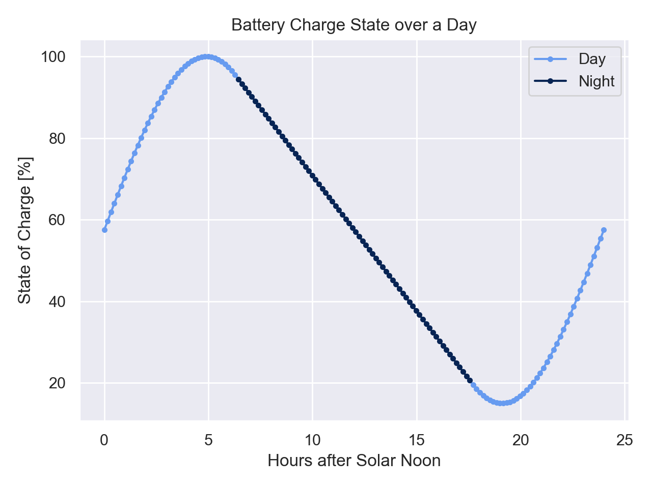
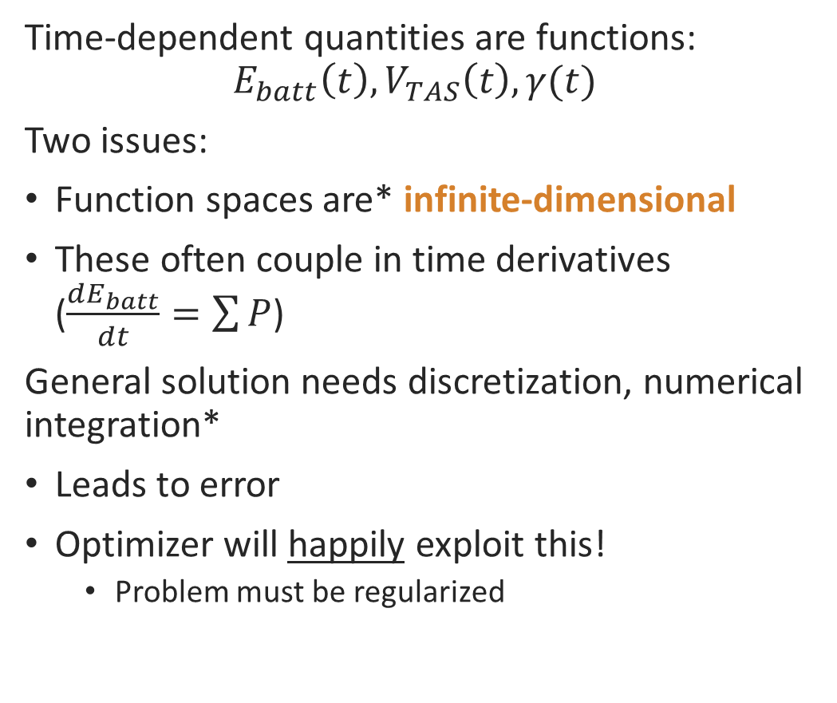
Optimizing in Time-Dependent Problems
Time-dependent quantities are functions:
$$E_{batt}\left(t\right), V_{TAS}\left(t\right), γ(t)$$
Two issues:
Function spaces are* infinite-dimensional
These often couple in time derivatives ($\frac{dE_{batt}}{dt}=\sum{P}$)
General solution needs discretization, numerical integration*
Leads to error
Optimizer will happily exploit this!
Problem must be regularized
Further reading from Boston Dynamics:
Trajectory Optimization with Direct Collocation
Notes:
General solution requires discretization, num. integration
Simple cases can sometimes admit closed-form solutions (e.g. Breguet range equation), but in general this is insufficient for our solar aircraft problem
Optimizing through an integrator
Dawn Design Tool uses second-order-accurate integrators, essentially the trapezoidal rule
One of the most common failure modes in numerical optimization of time-dependent engineering systems
Will show up as wiggles – exploiting the integration scheme

Slide 33
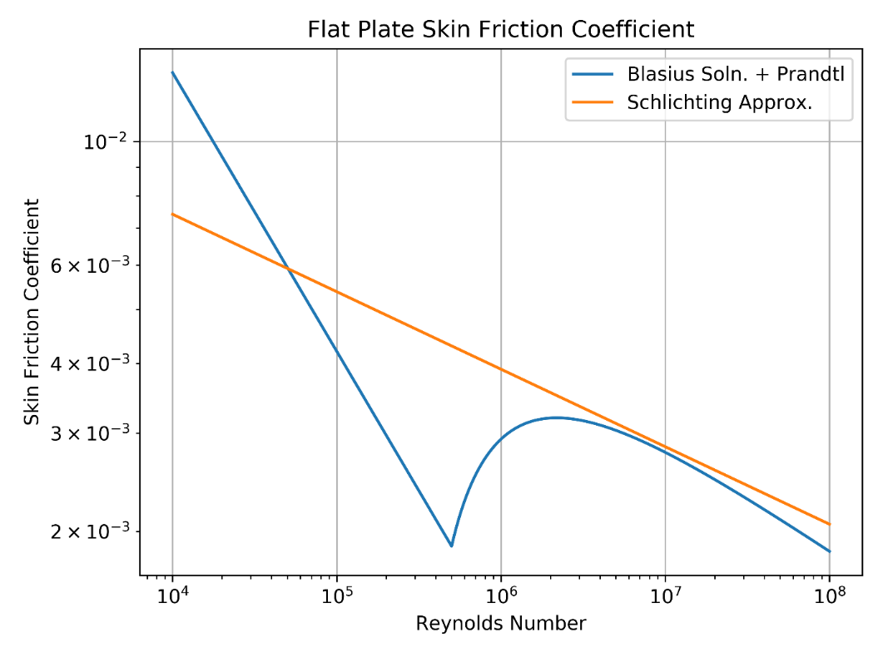
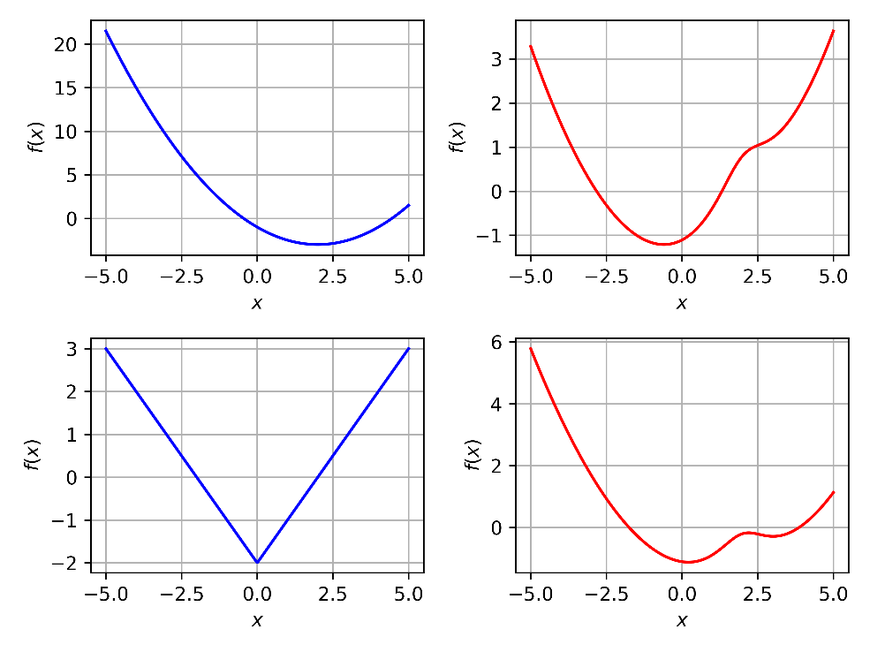
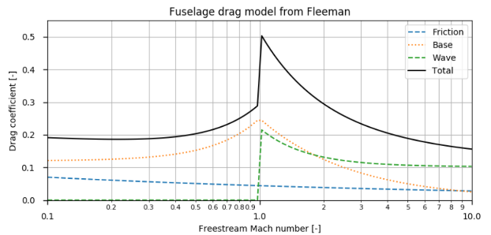
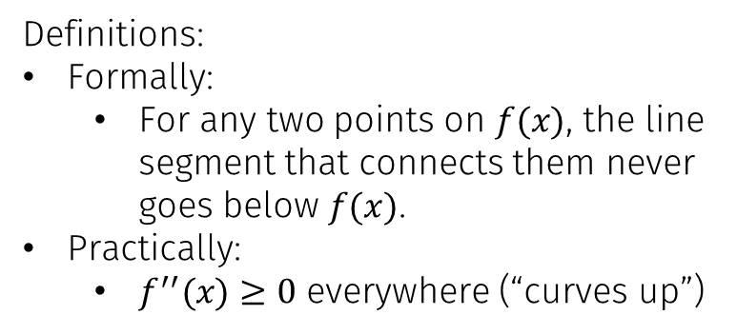
Backup: Convexity
Log-convexity
Many, but not all simple engineering models can be roughly approximated as log-convex
More complex models usually cannot
Convex and Nonconvex Functions
Definitions:
Formally:
For any two points on $f(x)$, the line segment that connects them never goes below $f(x)$.
Practically:
$f^{′′}(x)≥0$ everywhere (“curves up”)
Figure reproduced w/ permission from M. Vernacchia, “Modeling Compress. Aero. Of Aircraft in GPs” manuscript

Slide 34
AeroSandbox
A differentiable aircraft design framework

Slide 35

Framework Overview
AeroSandbox: An conceptual-level design optimization framework. Goals:
Make modern design optimization tools accessible to non-specialists
Declarative, not imperative – exploiting the 80/20 rule
Make optimization numerics as transparent as possible by default
Keep it lightweight
Minimize code development time in addition to runtime
Make model abstraction optional
Focus on low-fidelity, early-stage design exploration
Wide, not deep modeling
Notes:
Targets these challenges:
Highly coupled problems
Very high dimensionality
Time-dependent

Slide 36
Framework Overview
Features:
Modern gradient-based optimizers (IPOPT)
End-to-end automatic differentiability
Very fast way to compute gradients of code
Object-oriented aircraft geometry framework
Hundreds of mutually-compatible aerospace physics models + historical datasets
Very shallow learning curve:
Everything backwards-compatible with existing Python/NumPy code!
Notes:
Targets these challenges:
Highly coupled problems
Very high dimensionality
Time-dependent

Slide 37
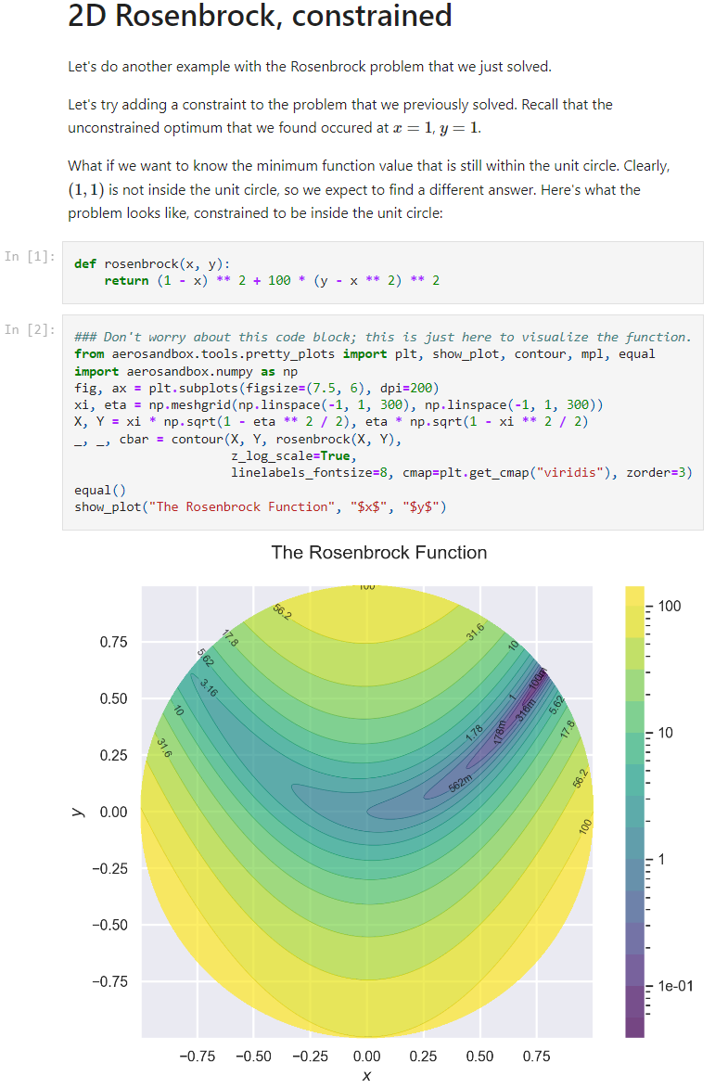
Framework Details
To install:
A single command in terminal, if you have Python installed:
If you’re new to Python: go to the AeroSandbox GitHub main page (Google “AeroSandbox”) and read detailed installation instructions
To get started:
On AeroSandbox GitHub main page, find links to many dozens of step-by-step interactive tutorials.
pip install aerosandbox

Slide 38
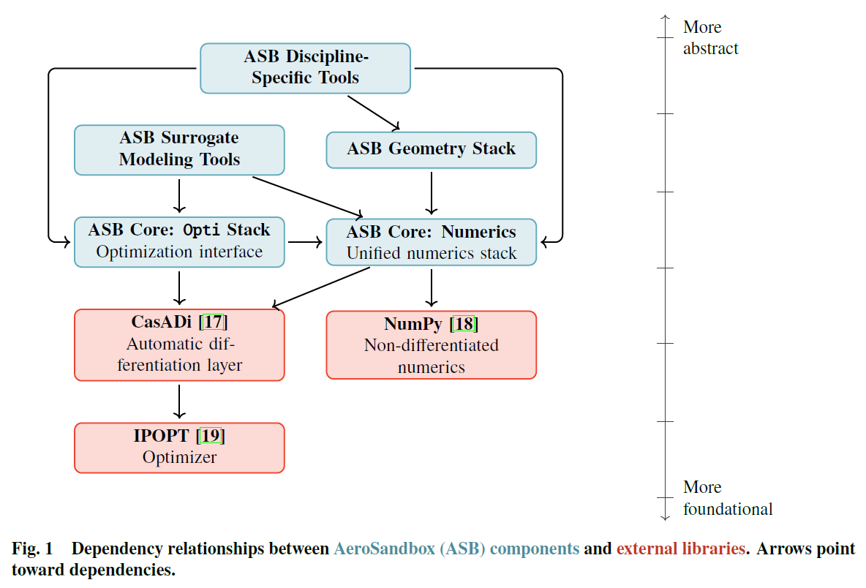
Framework Features
End-to-end automatic-differentiable numerics and optimization stack
Dozens of mutually-compatible differentiable aerospace physics models
Object-oriented aircraft geometry framework and performance stack
Surrogate modeling tools to build new differentiable models from user data
Notes:
Core Tools: An optimization framework that allows for the formulation and solution of engineering problems,and a numerics framework that enables seamless automatic differentiation for efficient gradient computation.
Modeling Tools: Tools for representing geometry (the backbone of engineering design) in an optimizer-friendlyformat, and tools that aid in creating custom surrogate models for user-defined physics via interpolation or fitting.
Discipline-Specific Tools: Collections of modular analysis tools aimed at specific aircraft design disciplines,such as aerodynamics, propulsion, and structures

Slide 39
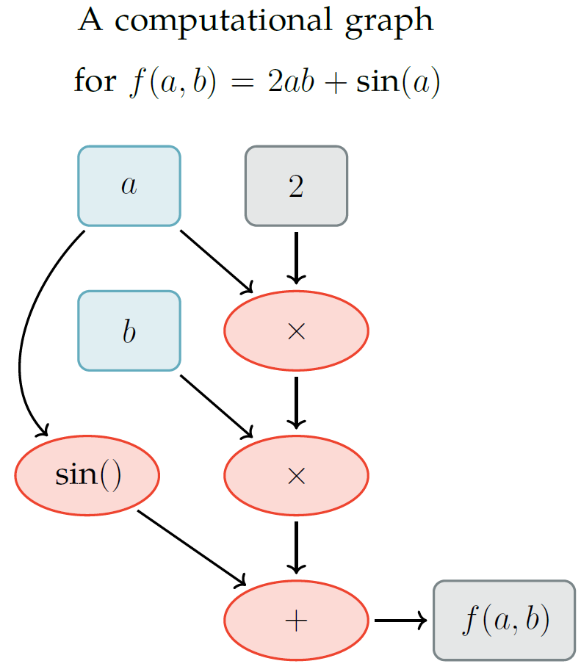




Automatic Differentiation (AD)
$$m$$
An efficient and accurate way to automatically compute gradients of code at runtime – never specify partials.
Time complexity for $\frac{∂f}{∂x}$, where $f\left(x\right): ℝ^{m} →ℝ^{n}$:
Forward-mode AD: $𝒪(m)$
Reverse-mode AD: $𝒪(n)$
Many design optimization problems have $n≪m$, so reverse-mode AD tends to be faster
E.g., for objective functions ($n=1$), calculate the gradient in $𝒪(1)$ time instead of $𝒪(m)$ time
Multidisciplinarity naturally yields Jacobian sparsity, offering further speedups via compression (coloring).
Downside (reverse mode): high memory
Scales with number of operations (nodes in computational graph)
$$\frac{∂f}{∂x}=J=\left[\begin{matrix}\frac{∂f_{1}}{∂x_{1}} & \frac{∂f_{1}}{∂x_{2}} \\ \frac{∂f_{2}}{∂x_{1}} & ⋱\end{matrix}\right]$$
$$n$$
Notes:
Here, we briefly review automatic differentiation, which is one of the way that the Opti stack accelerates optimization.
Automatic differention (or AD) is a way to compute gradients of code.
For a vector-valued function that maps from RM to RN.
AD in Neural Networks:
Neural networks: invented in the 1940s, explored extensively in the 70s
Abandoned until ~2010, when someone figured out how to do AD on GPUs
AD in optimal control:
Trajectory optimization, model predictive control
Boston Dynamics robots, SpaceX landings – both using flavors of AD (though a different kind of optimization)
For a function:
Accuracy figures assuming:
double precision floating point arithmetic
nonlinear functions with normalized curvature
best possible step size for finite-difference
If people are more curious, I have some extra charts with a simple AD example – we’ll skip for time, but happy to talk through at the end

Slide 40



Numerics Stack
Unified numerics module that automatically type-dispatches to appropriate backend, depending on datatype and differentiability needs:
CasADi (most mature)
Google JAX
NumPy/SciPy
Fallback means syntax is a superset of NumPy
Syntax mirrors NumPy exactly:
Most existing Python-based analyses can be used with AeroSandbox by simply editing the NumPy import
Differentiable coverage of almost all of NumPy, some parts of SciPy

Slide 41


AeroSandbox Syntax
Code syntax meant to exactly mirror natural engineering syntax.
Example problem:
Minimize the drag of a rectangular wing by changing chord and span, given:
Sea level atmosphere
$V_{∞}=1 \text{m}\text{/}\text{s}$, $C_{L}=0.4$
Fixed wing area $S=1$
A simple AeroSandbox program
opti = asb.Opti() chord = opti.variable(init_guess=1) span = opti.variable(init_guess=1) Re = velocity * chord / kinematic_viscosity CD_p = 1.328 * Re ** -0.5 AR = span / chord CD_i = CL ** 2 / (pi * AR) opti.subject_to(chord * span == 1) opti.minimize(CD_p + CD_i) sol = opti.solve() print(sol.value(chord), sol.value(span))
Make an optimization problem
Make design variables and set initial guesses
Model profile drag
Model induced drag
Constrain the wing area
Set an objective function
Solve
Show results
Imports/constants above
Result: $c=0.229$ m, $b=4.37$ m

Slide 42
Solving Example Aircraft Design Problems with AeroSandbox

Slide 43

Robustness: Simple Wing & Simple Airplane
Pair of first-order aircraft sizing benchmark problems (from GPKit; Hoburg and Abbeel).
7 design variables
Around 20 simple explicit and implicit physics models to close problem
Code mirrors optimization problem formulation line-for-line (75 lines)
Order-of-magnitude initial guesses

Slide 44

Robustness: Simple Wing & Simple Airplane
Problem is solved to known optimum in 22 milliseconds.
Robustness to initial guesses:
In practice, significantly less of a concern than one might initially expect.
In this case, we demonstrate convergence if variables are initialized to within two orders of magnitude of the optimum.

Slide 45












MIT Firefly: Design Problem
Folded size $≤$ 70 x 70 x 480 mm
Air-deployed
Mach 0.80
Altitude: 30 kft (9.1 km)
Maintain M0.80 for 60 seconds
Maximize total range
480 mm (19.0 in)
Drop
Unfold and stabilize
Powered flight
70 mm (2.75 in)
Glide
Ignite rocket
Disposal
Firefly CAD renders: Julia Gaubatz, MIT
F/A-18 Image: McDonnell Douglas
Notes:
Building upon previous lab work re: micro-UAVs

Slide 46

MIT Firefly: MDO Model
Combined vehicle and trajectory optimization
6 coupled disciplines
Aerodynamics
Structures & Mass Properties
Time-dependent Stability & Control
Propulsion
Trajectory / Dynamics
Volume accounting / Packaging (CAD)
3,910 variables, 8,420 constraints
~150 vehicle design variables
Nonlinear, nonconvex
6.9 seconds to solve on a laptop.
<600 lines of code to implement; due to plug-and-play models
Optimized result, visualized with ASB geometry engine
Notes:
6.9 seconds to solve on a laptop.
<600 lines of code to implement; due to plug-and-play models
This is really the more important thing:
Less than an hour from whiteboard sketch (“Will this configuration work?”) to an optimized answer

Slide 47

Configuration Overview
X Tail with lower fins actuated for control
Swing wing which springs out and locks at deployment
Servos placed in the nose to avoid thermal issues that would arise near the aft end of the motor
Pull-spring control surface actuation
Torsion springs in oblique hinge provide fin-opening moment
Servo pulls cable to provide fin-closing moment
Firefly CAD renders: Julia Gaubatz, MIT

Slide 48

Example: The Firefly Design Problem
Simultaneously optimizing...
Mission Profile (simulation/control)
Aircraft Design
Design Variables
Hundreds, including:
wing, stabilizer, fuselage geom.
nozzle dimensions
propellant mass and chemistry
insulation thickness
Parameters
canister dimensions
payload dimensions
overall configuration
Operational Variables
Thousands, including:
altitude
airspeed
oxamide distribution
ctrl. surf. inputs
Parameters
altitude constraints
speed requirements
propulsion requirements & margins (e.g. no flame-out)
Objective Function
Maximize total range
Constraints
Physics models
~150 models, 8,000 constraints
Notes:
Two key case studies that we’ll talk about today
I’ve chosen them because they’re at opposite “corners” of the aircraft design space
Firefly: Mach 0.8 rocket-propelled micro-UAV
Matters not only what you fly, but also how you fly
Especially in the case of a solid rocket propellant, your thrust profile is “baked in” to the design
Firefly rides the critical mach line
Any misstep in trajectory, overspeed -> strong shock waves, all that excess energy is burned off as wave drag
If you look at energy loss as a function of “excess mach”, it’s locally “excess mach” to the 5th power
You really hit a wall

Slide 49


3D Aerodynamics Methods
AeroBuildup: DATCOM-like method
Generalizes to arbitrary wing-body configurations
Vectorized across operating points
~5000 operating points / second
Viscous and compressible effects, nonlinear
Can optionally link to XFoil/MSES for sectional aerodynamics
Smooth, with sensible extrapolation to 360$°$ $α$, $β$ – suitable for optimization
Vortex Lattice Method
Nonlinear lifting line
Implicit; convergence against viscous sectional aerodynamics
Notes:
DATCOM
Collection of several dozen best-practices models
Some come from theory, others are fits to wind tunnel data and high-fidelity CFD from literature
Aero features
Low-Re CL and C_L-alpha changes
Transonic lift drop due to shock formation
Wing: On-the-fly, caching surrogate model developed from MSES

Slide 50

3D Aerodynamics Methods
Data from AeroBuildup Validation Study (Sailplane1)
In addition to forces/moments, methods give stability derivatives
3D, static and dynamic
Vectorized across mass properties (e.g., time dependent CG)
Validate well against existing low-fidelity tools (AVL)
All methods are differentiable, and AD is closed under differentiation, so for explicit methods we can directly apply stability constraints:
$C_{mα}≤−0.50$, $C_{nβ}≥0.05$, $C_{m}=0$
Shared API
Output | AeroBuildup | AVL | Significant Deviations?
CD | 0.02 | 0.01 | Expected
CL | 0.45 | 0.46
CLa | 6.30 | 6.07
CLq | 2.72 | 9.42 | *
CYb | -0.17 | -0.17
CYp | -0.36 | -0.22 | *
CYr | 0.10 | 0.12
Clb | -0.18 | -0.17
Clp | -0.72 | -0.64
Clr | 0.07 | 0.13 | *
Cm | 0.13 | 0.19
Cma | -1.69 | -0.95 | *
Cmq | -11.0 | -12.8
Cnb | 0.01 | 0.02
Cnp | -0.09 | -0.04
Cnr | -0.02 | -0.02
D | 29.5 | 11.7 | Expected
L | 805 | 815
m_b | 35.8 | 50.6
Notes:
Directly constrain stability derivatives
Higher order automatic differentiation

Slide 51


Flight Dynamics Engine
Modularity via abstraction:
Dimensionality: 1D, 2D, or 3D
Complexity (fastest relevant mode):
Steady (single-point)
Energy conservation (excess power)
Phugoid (airspeed)
Short-period ($α$, $β$)
Inertial ($p$, $q$, $r$, $δ_{e}$, $δ_{a}$, $δ_{r}$, $I$)
Newtonian or energy-based velocity parameterization
Integrator order: Euler, trapezoidal, Simpson, RK4 (WIP)
Shared API
Switchable with one line – move up and down the fidelity ladder

Slide 52


Flight Dynamics Engine
Modularity via abstraction:
Dimensionality: 1D, 2D, or 3D
Complexity (fastest relevant mode):
Steady (single-point)
Energy conservation (excess power)
Phugoid (airspeed)
Short-period ($α$, $β$)
Inertial ($p$, $q$, $r$, $δ_{e}$, $δ_{a}$, $δ_{r}$, $I$)
Newtonian or energy-based velocity parameterization
Integrator order: Euler, trapezoidal, Simpson, RK4 (WIP)
Vectorized, explicit or implicit (direct collocation)
Minimum-Altitude-Loss Trajectory for Cessna 152
With Engine INOP on Climbout, Downwind Approach

Slide 53
Example Problem: Aerodynamic Shape Optimization
Next, we demonstrate optimization through one of the many plug-and-play analysis tools included with AeroSandbox.
Vortex Lattice Method aerodynamics flow solver.
Combined with differentiable meshing through the AeroSandbox geometry stack.

Slide 54

Example Problem: Aerodynamic Shape Optimization
Problem:
Minimum-induced-drag wing planform, under typical assumptions detailed in paper:
Known solution (elliptical wing), so we can compare optimization results to theory.

Slide 55

Example Problem: Aerodynamic Shape Optimization
Initial guess:
Rectangular wing
$c\left(y\right)=0.5$
$α=5°$
Infeasible ($C_{L}$ and $S$ constraints violated)

Slide 56
Example Problem: Aerodynamic Shape Optimization
Problem solves in 14 iterations.
Optimized result:
Elliptical wing
All constraints satisfied

Slide 57



Example Problem: Aerodynamic Shape Optimization
Problem solves in 14 iterations.
Optimized result:
Elliptical wing
All constraints satisfied

Slide 58


Development Tools for New Analyses
Differentiable Geometry and Meshing (various levels of degenerate geometry)
N-dimensional Splines for Structured or Unstructured Datasets

Slide 59


Other Composable Discipline-Specific Models
Probabilistic atmosphere, wind speed, and gust models
6-DoF Euler-Bernoulli Beam Models
Notes:
Differentiable thermodynamics library for jet engine cycle analysis
Propeller modeling
Electric & ICE motor models
Historical weight models for various aircraft components
Mass properties accounting and optimization w.r.t. these mass properties
2D airfoil panel method with IBL coupling (automatic-differentiable XFoil)

Slide 60


Example Outputs: Mass/Volume/Power/Cost Budgets
Drawing: Mark Drela

Slide 61

Example Outputs: Mission Feasibility Maps

Slide 62

Design Sensitivities
Design sensitivities can be calculated and used to inform subsystem-level decisions
Examples:
Motor efficiency vs. motor mass
Marginal benefit of dollars spent on advanced battery technologies
Identifying active and inactive constraints in requirements
What’s limiting the design?
Figure of Merit | Estimated Sensitivities of Wingspan as of Aug. 2020
Any added mass | 0.303 m/kg
Any added power draw* | 0.0172 m/W
Any added drag | 0.705 m/N
Battery spec. energy | -0.110 m/(Wh/kg)
Battery packing fraction** | -0.546 m/(%)
Solar cell efficiency** | -0.984 m/(%)
Solar cell area density | 18.4 m/(kg/m^2)
Propeller COP** | -0.819 m/(%)
Motor Efficiency** | -0.773 m/(%)
Nighttime Altitude | 4.13 m/km
$$\frac{∂(\text{wingspan})}{∂(\text{variable})}$$
* Assumed constant over 24 hours
** Derivatives w.r.t. percentages are in terms of absolute percentage points (i.e. 25% → 26%), not multiplied percentages

Slide 63
Optimization Caveats
Engineering time is often (implicitly) part of your objective function
80% of the optimization benefit comes from 20% of the work – 1st-order models go exceptionally far
Identify sensitive models and assumptions, then focus on refining those
Notes:
Engineering time is part of your objective function
Low-fidelity models go far
Capture simple physics: focus on breadth, not depth of modeling
Do not blindly trust an optimizer
We forget constraints that seem intuitive
Example
A design study this summer required us to constrain the wingspan below an amount that the optimizer was “happy” with
Optimizer changed to a canard design, shrunk the “wing” and made the “horizontal stabilizer” the primary lifting surface
In nature, optima are usually not near extremes
Goes back to what Mark was saying about how your mass fractions should be roughly comparable

Slide 64
Optimization Caveats
Do not blindly trust an optimizer
An optimizer only solves the problem you give it
Often, we forget “obvious” constraints
Optimizers are adversarial and will exploit any flaw in your model – garbage in, garbage out
Weird answers are almost always the right answer to the wrong problem, not the wrong answer to the right problem.
Without special care, optimized designs are almost always fragile
An optimizer will often naturally drive to the edge of the feasible space
In nature, optima are usually not near extremes
Add margin!
Make sure your optimized designs pass the TLAR (“That looks about right”)
Optimization is just one tool in the design toolbox – interpret results.
Notes:
Engineering time is part of your objective function
Low-fidelity models go far
Capture simple physics: focus on breadth, not depth of modeling
Do not blindly trust an optimizer
We forget constraints that seem intuitive
Example
A design study this summer required us to constrain the wingspan below an amount that the optimizer was “happy” with
Optimizer changed to a canard design, shrunk the “wing” and made the “horizontal stabilizer” the primary lifting surface
In nature, optima are usually not near extremes
Goes back to what Mark was saying about how your mass fractions should be roughly comparable

Slide 65

Happy Optimizing!
Notes:
Optimization is probably *the* mathematical problem that is using up the most computer cycles around the world right now – it’s fascinating, useful, and worth doing!

